Slide 1


Infection Prevention and Control considerations for Primary Care environments.

Slide 2

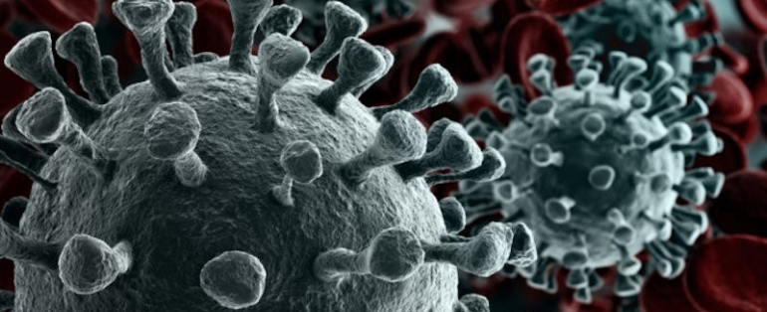
ICB Infection Prevention Team
Please contact us below for any queries relating to primary care:
Vanessa Morris - vanessa.morris2@nhs.net
Hannah Goldsmith - Hannah.goldsmith5@nhs.net
Adele Quinn- adele.quinn2@nhs.net
Generic inbox – Iscicb-el.infectioncontrol@nhs.net
Hours of Work: Monday – Friday 8-5pm.

Slide 3
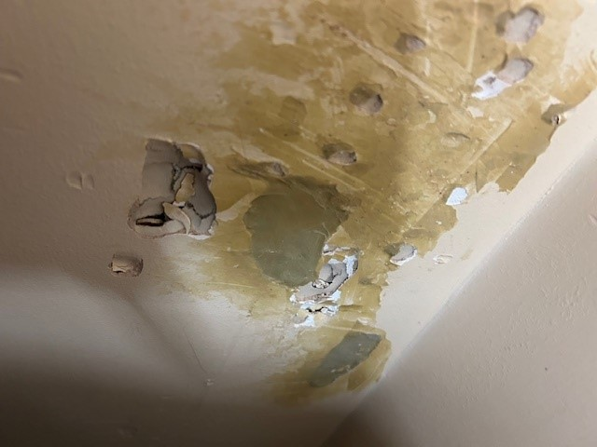
Things to consider:
An environmental audit ideally should be carried out every 6-months-especially in clinical areas or annually for the whole building, as a bare minimum.
Infection Prevention Control - environment audit 2025
Observe for any damages to the building- report to the ICB Estates team (email philip.hargreaves@nhs.net who will be able to direct you to the Estates co-ordinator for your locality.

Slide 4
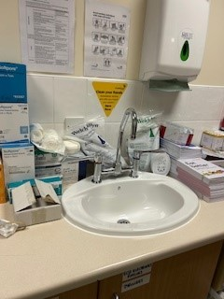
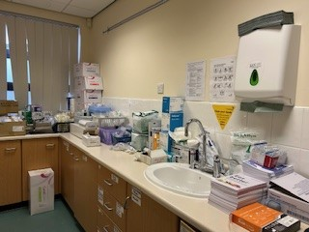
De-clutter work benches, sink areas. To enable efficient cleaning and prevent items being contaminated with waterborne pathogens such as Legionella- (through splash back):
Items should be stored in an enclosed stacker system/cupboard to keep dust free too.

Slide 5
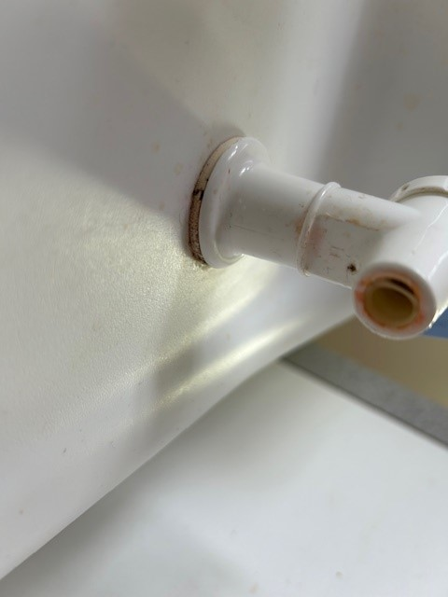
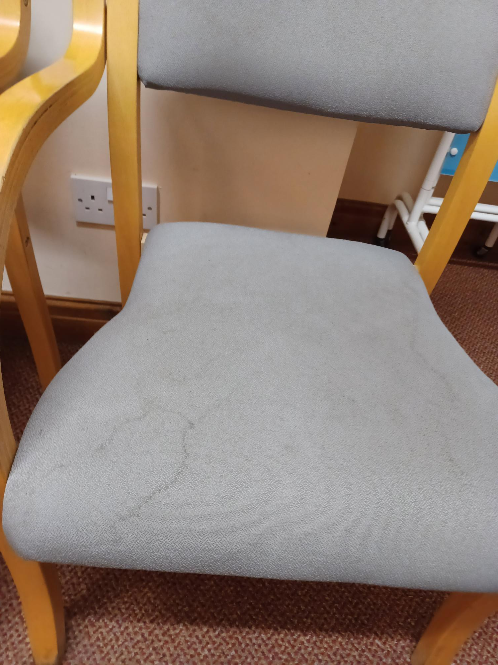
Check underneath items for dirt- such as taps on a water dispenser and underneath toilet roll holders:
Are chairs wipeable?

Slide 6
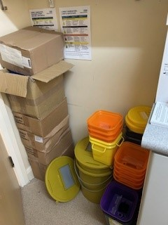
Further considerations:
Consider displaying cleaning checklists in each individual room (adapt for each specific room)- include a cleaning check list in the kitchen to include items such as a microwave.
Drugs/vaccine fridges need to be on a cleaning schedule. Use following check list:
Safe-Vaccine-Management checklist 2025 PDF
There should be no floor level storage.
Annual ANTT assessments for all staff involved in clinical care.
Aseptic technique competency: Annual Assessment Tool for General Practice.

Slide 7
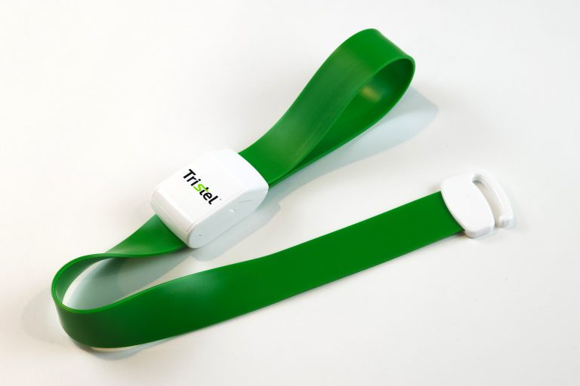
Considerations:
Curtains to be changed, as per below:
Curtain-changing-or-disposal-frequency-for-General-Practice
          Re-usable equipment needs to be wipeable or single use- e.g. no cloth tourniquets.
Daisy grip is one example of a reusable tourniquet that can be purchased:
Product Code: TSLDG001
NHSSC: FVH85099

Slide 8
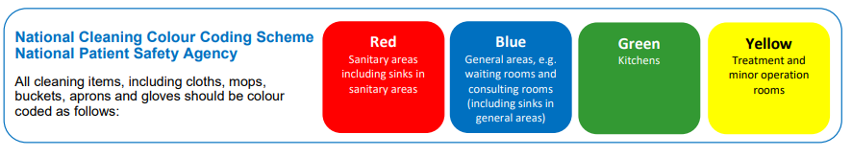
National colour coding system should be in place throughout the surgery:

Slide 9
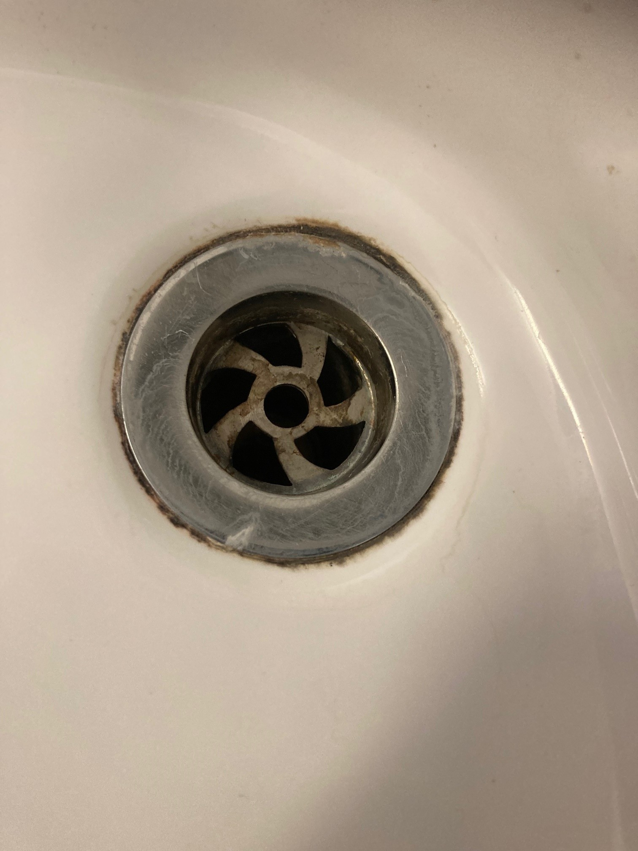
Water Safety
Taps at all sink outlets need to be flushed regularly see link-use this form to record this is being completed:
Tap run off sheets.
If sinks are no longer in use e.g ones in a storeroom- consider their removal via contacting the Estates team.
Display hand-wash only signs above all clinical hand wash sinks- ensure drinks are not being poured down the sink (they act as a nutrient for waterborne pathogens).
Hand wash sink GP practices, 2025
Are plug holes clean?

Slide 10
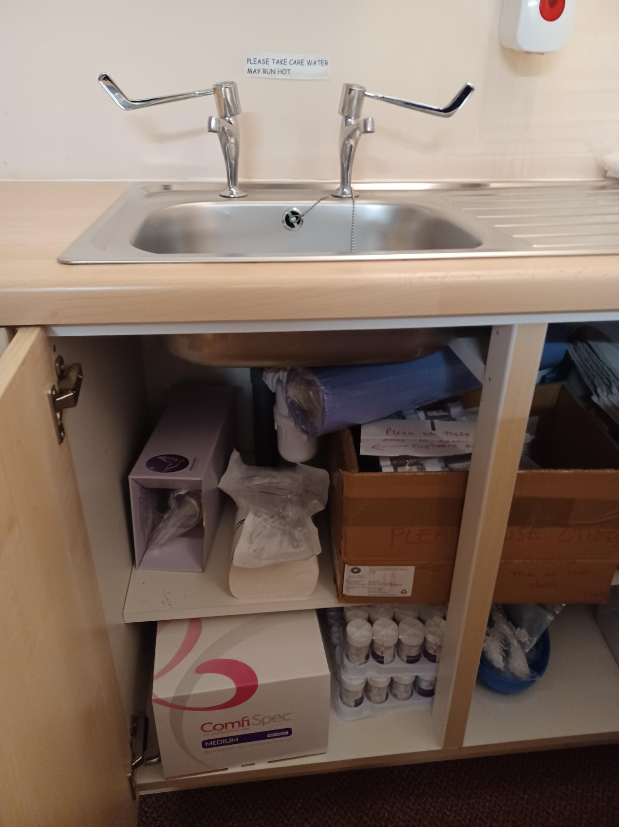
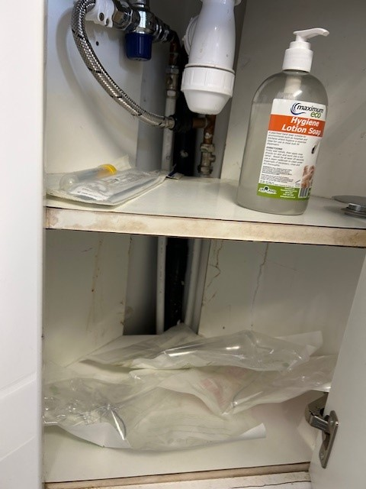
Check items are not stored underneath the sinks- U-Bend :
Items can become contaminated.

Slide 11
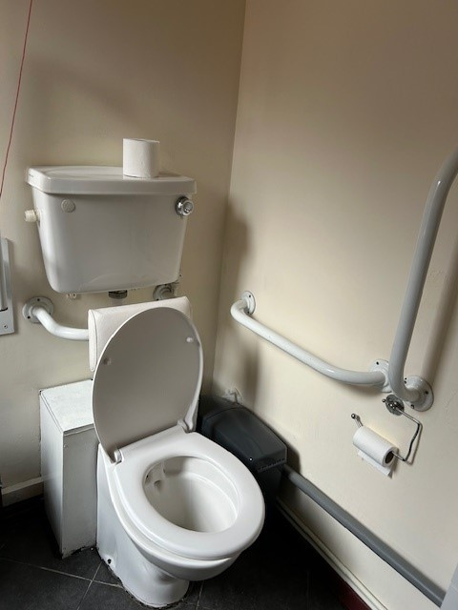
Promote a hygienic environment:
Access to hand sanitiser in all clinical rooms/ waiting areas/disinfectant wipes/availability of a Spill kit.
Ensure all toilet rolls are within an enclosed toilet roll holder (same for paper towels).
Provide tissues in a waiting room and a waste bin. Surgical face masks for patients with respiratory symptoms.

Slide 12
Hand hygiene:
Carry out monthly hand hygiene audits which includes checking that clinical staff are bare below the elbows/no nail varnish/false nails (this can be delegated to other members of staff to complete).
Hand-hygiene-compliance-Monthly-Audit-Tool-for-General-Practice-
Planned building work/alterations:
Please complete a risk assessment form –once completed send to the IPN team (Iscicb-el.infectioncontrol@nhs.net) and Estates team (Philip.hargreaves@nhs.net)
Risk assessment for building work HBN 00-09-ICB

Slide 13
Maintaining a safe environment prevents the risk and spread of infections.
Infection Prevention is everyone’s responsibility.

