Slide 1
















Shaping Tomorrow’s Leaders How Lighthouse Supports the NHS
Proud to be supporting these NHS organisations
Notes:
Proud to be supporting these NHS organisations

Slide 2
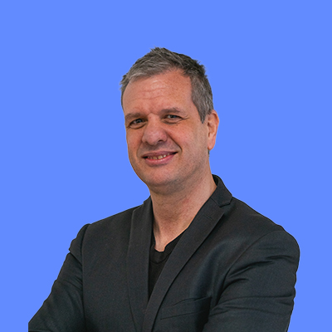
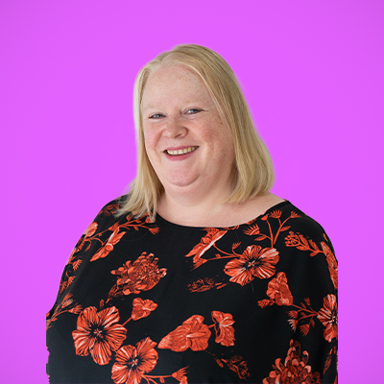
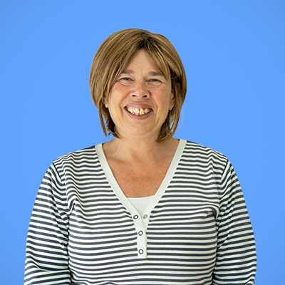

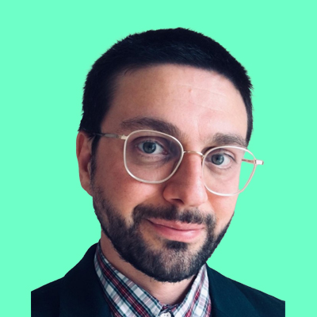
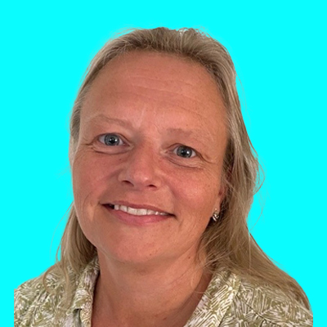
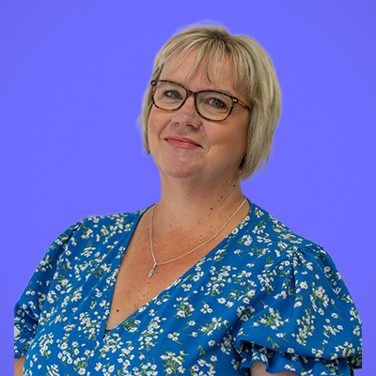
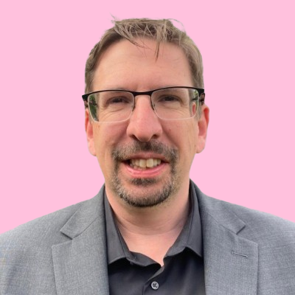
Welcome
Our Speakers
Your Host
Matthew Rawlings
Client Relationship Manager
Gill Shimmon
Managing Director
Charlie Hill
Director / Head of Programmes
Michael Manson
Directorate Operations Manager,
Norfolk and Norwich University Hospitals NHS Foundation Trust
Available for questions
Paul Tipper
Programme Officer – Leadership Programmes/ Apprenticeships, NHS England
Corinna Thomas
Strategic Lead for Standards and Frameworks, NHS England
Samm Gardiner
Apprenticeship Tutor and Quality Lead
Alan Beale
Customer Insight and Strategy Lead

Slide 3
Agenda
Lighthouse and our journey supporting the NHS
Gill Shimmon, Managing Director, Lighthouse
Building Collaborative Relationships, our approach to partnership working Gill Shimmon, Managing Director, Lighthouse
Leadership apprenticeships overview
Charlie Hill, Director, Lighthouse
Learner Story - sharing his journey as a former learner Michael Manson, Norfolk and Norwich University Hospitals NHS Foundation Trust
Programme Spotlight - Exploring: Level 6 Career Development Professional & Level 4 Learning Skills Mentor
Charlie Hill, Director, Lighthouse
Q&A Session
Add your questions in the chat box throughout the webinar
Notes:
Leadership apprenticeships overview

Slide 4



Lighthouse and the NHS
It all started with…….
+

Slide 5



Collaborative Relationships
Partnership Working
Learner journey & development
Ongoing support & communication
Notes:
Matthew is our main point of call for commissioners, working closely with our operations team
PARTNERSHIP WORKING
In house and open options – particularly passionate about system wide programmes – my colleague will talk more about this later!
Either way it is all about understanding your organisation, your people, your challenges and opportunities, individual needs
Onboarding each organisation – understanding reporting requirement, hierarchies, stakeholders etc.
Key contacts and their roles (you and us)
Contracting (rules!!) (typically using Salisbury Managed Procurement Services or occasionally Crown Commercial Services)
How you want to work with us
Where in-house, detailed programme planning to make the programme really work for you – this is where we really excel!!
Where possible including internal speakers to bring topics to life
LEARNER JOURNEY AND DEVELOPMENT
When each organisation has been on-boarded we then get started with the learners
All attend an IAG event – open (monthly) or can be arranged in house. Overview of programme, ‘rules’, and chance to meet the trainers and tutors who deliver the programme with a deeper dive of each standard we offer
Line Managers are also involved in these – they are critical to success and need to understand their role
Programme dates etc. provided at start for whole programme – able to plan ahead
Dedicated trainer/tutor for whole of programme
Regular reviews involving line manager with reporting to the commissioner
Additional ad hoc support as required – based on learner needs
Pastoral support, including supporting any additional learning needs and adjustments required
Practical support for End Point Assessment
ONGOING SUPPORT AND COMMUNICATION
Regular reviews with commissioners – monthly, quarterly etc.
Programme news/updates
Newsletters – useful information
Whatever you need really
We want to still be working with you 10 years from now (with many organisations that is exactly what we do!!!) so this really is a partnership.
When things go right, we want to share it with you…when things go wrong we want to work with you to fix it!
We would love to have a 1-1 conversation with each and every one of you to explore your leadership development plans and how we may be able to support you
Now going to pass you over to my colleague Charlie who is going to dive specifically into our NHS Programmes and also share details on some new standards we think might be of interest!
Regular meeting to check-in on learner progress, outstanding issues and new prospects
Yearly face to face meetings
Dealing with regular queries
Onboarding of new learners
Information and Guidance sessions – tailored if needed to your individual needs
Individualise help
Support and guide
Discuss and Investigate new programme design
Discuss business needs and develop solutions
Completion of contractual elements
Ongoing support and communication, Learner journey & development, Strategic partnership and delivery

Slide 6


Leadership and Management Apprenticeships
Level 3 Team Leader
Level 3 Business Administrator
Level 5 Operations Manager
Paul Tipper
Programme Officer – Leadership Programmes/ Apprenticeships, NHS England
Notes:
Edward Jenner programme
building a strong foundation of leadership skills
All on-line – done at your own pace
TL & BA as there is some cross-over
feedback is that it is interesting to do – not a huge cross over with the apprenticeships
Mary Seacole programme
a lot of crossover with the apprenticeship – works really well
Start with apprenticeship
then do the Mary Seacole programme – 6 months
finish with the apprenticeship – coaching and project management
Feedback says hard work but worth it
To do the Mary Seacole with us, have to combine it with the Apprenticeship
Paul Tipper here to answer any questions – please submit on chat

Slide 7
What is your view of the Mary Seacole Programme?

Slide 8
Learner Journey – L5 Operations Manager with Mary Seacole
Launch
Tutorial
You as Leader
Mary Seacole Workshop 1
Group Call
Mary Seacole Workshop 3
Tutorial
Leading Change
Operational Planning
Tutorial
Months 1-2
Months 3-4
Months 5-6
Months 7-8
Months 9-10
Months 11-12
Months 13-14
Month 15
Organisational Governance
Group Call
Mary Seacole Workshop 2
Group Call
Coaching
Tutorial
Strategic Direction
Presentation Skills
GATEWAY
Monthly
E-learning
Monthly Gathering Evidence for Portfolio
Monthly Line Manager Meeting
3 monthly Reviews with Tutor and Line Manager
Quest Report
360 Report and Feedback
Mentoring
Peer-to-peer Learning
Business Improvement Project

Slide 9
Are you aware of the NHS Management and Leadership Frameworks?

Slide 10
Leadership and Management Apprenticeships with NHS Leadership Academy
Programme will be refreshed
Not many changes expected
Will align very closely with Management and Leadership Framework

Slide 11
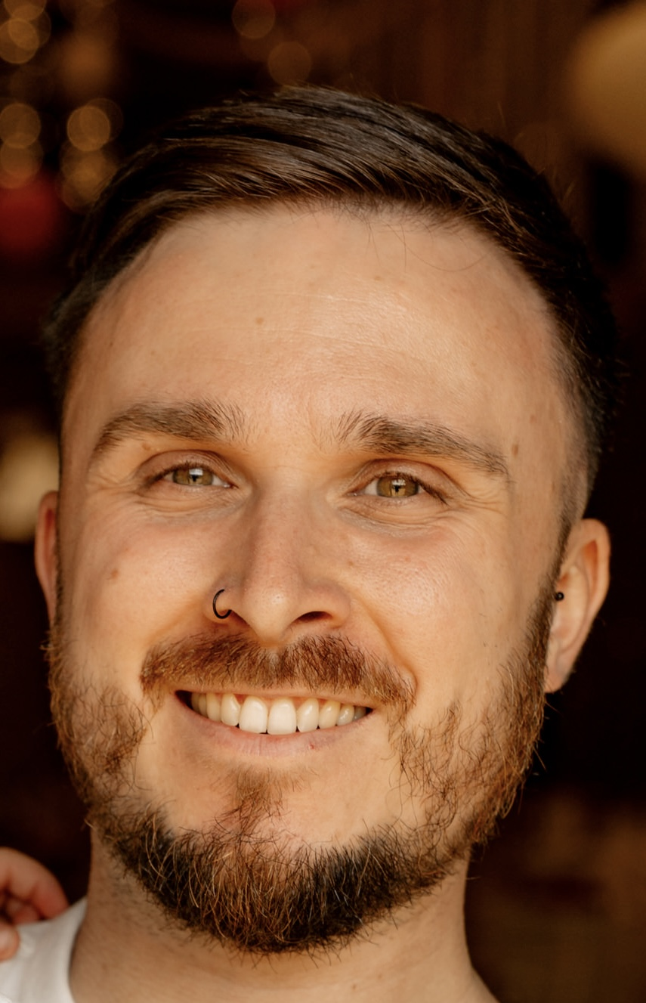
Michael Manson: The apprenticeship journey
Received Distinction in L5 Operations/Departmental
Apprenticeship

Slide 12


Up-coming News and Programmes
Potential Start - March 2026
Learning & Skills
Mentor Level 4
Careers Development Professional Level 6

Slide 13
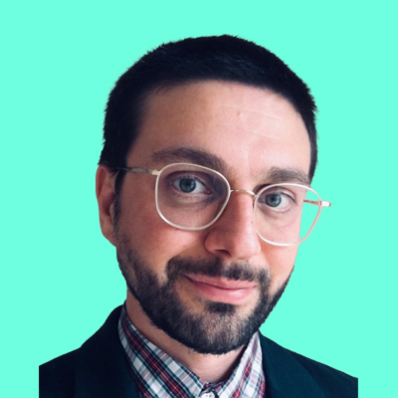
Any Questions?
Gill Shimmon
Managing Director
Charlie Hill
Director / Head of Programmes
Michael Manson
Directorate Operations Manager, Norfolk and Norwich University Hospitals NHS Foundation Trust
Paul Tipper
Programme Officer – Leadership Programmes/ Apprenticeships, NHS England
Samm Gardiner
Apprenticeship Tutor and Quality Lead
Corinna Thomas
Strategic Lead for Standards and Frameworks, NHS England

Slide 14
07783553314
Thank you
Matthew Rawlings
Client Relationship Manager Telephone: 07783 553 314
mattr@lighthouse-group.co.uk
Corinna Thomas
Strategic Lead for Standards and Frameworks, NHS England
corinna.thomas@nhs.net
Notes:
www.lighthouse-group.co.uk/nhs-leadership-academy

