Slide 1


Looking After Your Team’s Health and Wellbeing Guide.
Supporting our Primary
Care Colleagues.

Slide 2
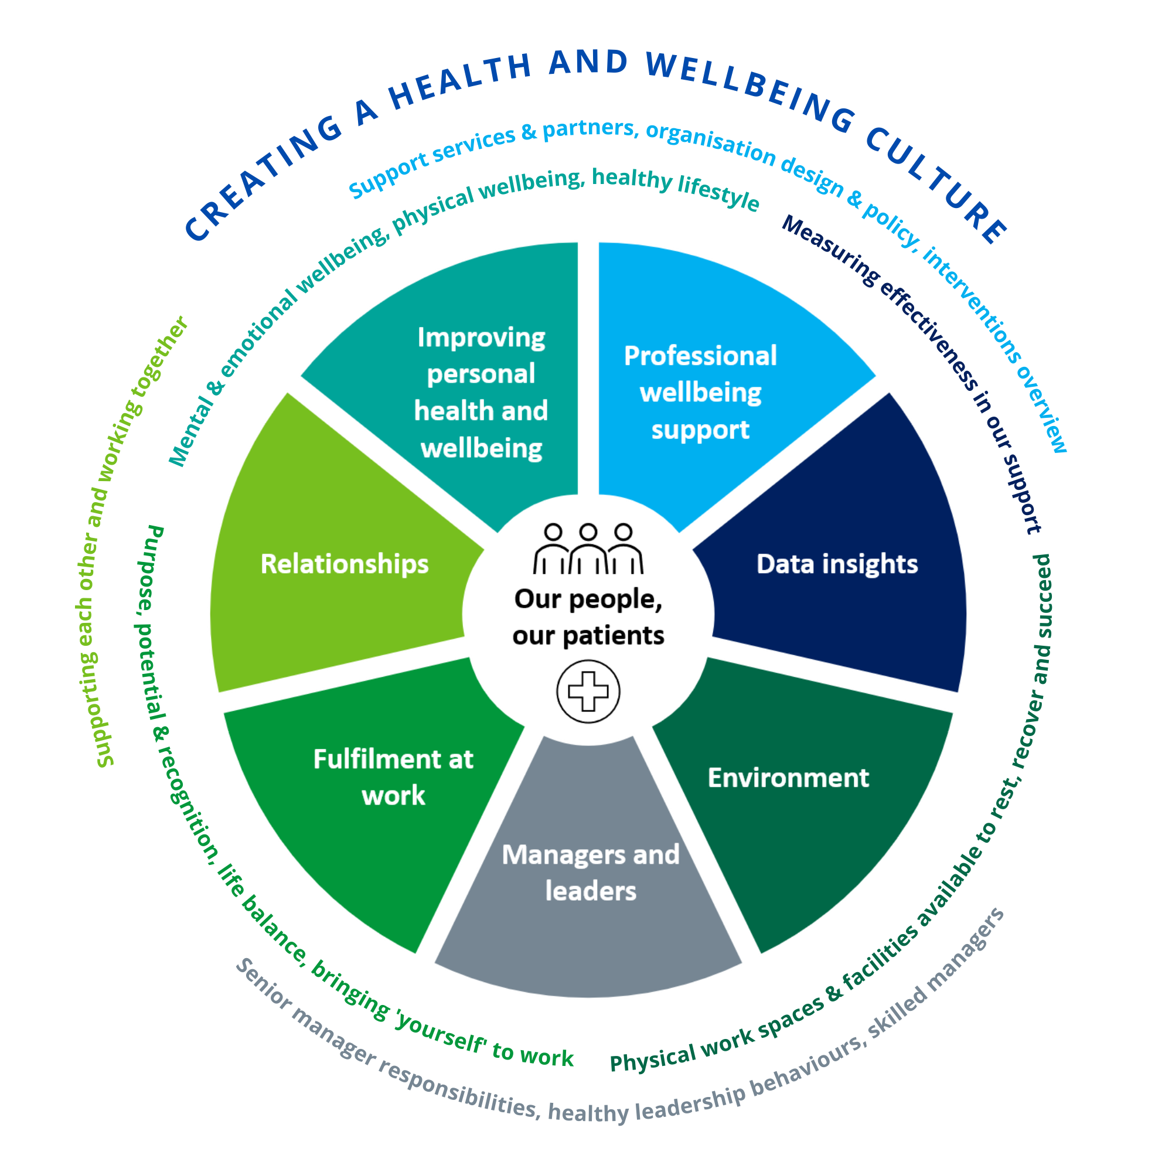
Why Was This Guide Created?
“Health is a state of complete physical, mental and social wellbeing and not merely the absence of disease or infirmity.” (World Health Organisation 2021)
When NHS England refreshed the Health and Wellbeing Framework in 2021, one of the things people said, was that they would really like a guide that supported them to grow wellbeing in their team.
There are lots of initiatives that support organisational or sector wellbeing, but people recognised that they spend most of their time with their immediate team and the wellbeing of that group of people was crucial to them.
Inspired by the NHS Health and Wellbeing Framework and the Healthy Leadership Framework, this guide has been co-designed with colleagues across health, social care and voluntary sectors to support teams across a range of organisations on a journey to grow their team wellbeing culture.
Watch this video explaining why this guide was created

Slide 3





Aim of The Guide
This guide is for use by all teams working in health and care, inclusive of all team forms and functions, across healthcare, primary care, social care and voluntary sectors, creating a culture change approach.
Data suggests that for almost 70% of people, their manager has more impact on their mental health than their therapist or doctor – and it’s equal to the impact of their partner (Forbes, 2023).
The guide will…
For more information & guidance click on this link
…provide inspiration and guidance to begin creating your local culture of wellbeing in a simple, practical & engaging way
…improve your team’s health and wellbeing over time, through a flexible, continual, and collaborative ‘journey’
…share best practice resources all in one place, whilst also signposting you to wider resources and tools over time as we learn together from your experiences.
…empower you and your team to explore and improve your health and wellbeing in an inclusive and holistic way
Introduction & Getting Started

Slide 4
Wellbeing Conversations
Regular, supportive, coaching-style one to one conversations that focus on the wellbeing of your colleague.
Considers the whole wellbeing of an individual in the conversation (e.g. physical, mental, emotional, social, financial, lifestyle, safety).
The aim is to create cultures where people feel heard and valued, and in which diversity is respected.
They are: They are NOT:
Caring and compassionate
Employee led
Supportive
On-going and dynamic
Inclusive.
Therapeutic interventions
Judgemental or performance related
A formal mental health assessment
For more information on Wellbeing conversation click on this link
Wellbeing conversations

Slide 5











What Does The Guide Include?
Within the guide, Teams will explore:
How to identify your team’s wellbeing goal(s) – with action plan template
Collaborative and supportive relationships that promote social wellbeing
Creating a safe and inclusive space to talk about wellbeing
Finding meaning in the work you do and bringing your whole self to work
Looking after your emotional, physical, mental health
Knowing where to go when you need wellbeing support
Ensuring you have a safe working environment
How to revisit and review your team’s wellbeing culture and goals
The inspiration library – more resources and ideas

Slide 6



The Facilitators Guide
The first step is picking up this guide and being interested in your team’s wellbeing!
Secondly - recognise that this is your team’s journey, and the journey you take will be the right one for you.
Advice includes:
Preparing yourself to lead the activity
Preparing your team
Doing the activity
Embedding and sustaining the outcomes from the activities
Anyone can facilitate an activity, so to help with preparation, please see this
Facilitators Guide
Use the traffic light tool to understand your team’s current culture wellbeing culture and where to focus your efforts.
This action plan template will help you organise any actions your team have suggested and identify action owners.

Slide 7
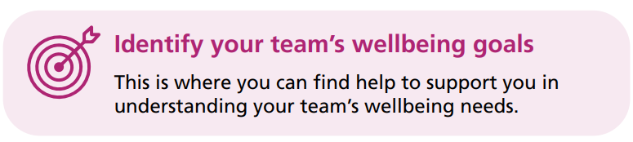
The Section Covers:
reviewing team wellbeing (to encourage team members to share how they feel)
identifying individual wellbeing goals (to encourage team members to actively work on their wellbeing)
using data to check how things are going (to encourage team members to identify measures of success).
identifying team wellbeing goals (to encourage team members to actively work on wellbeing as a team)
having structured health and wellbeing conversations (to enable team members to develop a personalised wellbeing plan)
For more information on identifying your team goals, click on this link Identifying Your Team's Wellbeing Goals
Quick Wins Activities
Wellbeing conversations scheduled throughout the year.
Showcase compliments and good feedback.
More Lengthy Activities
Use data available to identify themes.
Peer to peer wellbeing conversations.
Capture and track your team's progress.

Slide 8
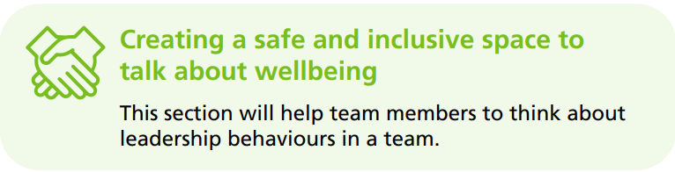
The Section Covers:
recognising healthy leadership behaviours
developing team inclusivity (to enable team members to connect and get to know one another on a deeper level)
recognising bias (to enable team members to identify ways to foster inclusion in the team)
Quick Wins Activities
Download the Healthy leadership framework and display it in your workplace.
Free access to the online Edward Jenner leadership course.
Create informal opportunities to check in with the rest of the team.
More Lengthy Activities
Develop a culture of support among the team.
Review your healthy leadership behaviours to promote positive H&WB.
Recognising and celebrating the team as individuals.
Recognising bias - https://www.youtube.com/2g88Ju6nkcg
For more information on creating safe & inclusive space to talk, click on this link
Creating safe & inclusive spaces

Slide 9
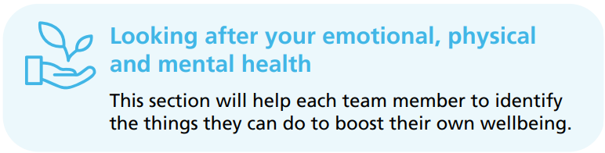
What Section Covers
developing a ‘five ways to wellbeing’ team challenge (to build team wellbeing commitments)
staying healthy while hybrid/remote working (to identify actions that team members can take to look after their wellbeing while working hybrid/remotely)
spotting the early warning signs and taking action (to agree how team members will recognise and support one another’s wellbeing).
Quick Wins Activities
Take a break with a colleague, lunch, short walk, or a cup of tea.
Take part in health challenges.
Practice doing small acts of kindness for others.
share ideas and tips for a Wellbeing Wednesday (Action For Happiness)
More Lengthy Activities
‘Five ways to wellbeing’ team challenge – connect, be active, take notice, keep learning, give (https://neweconomics.org/uploads/files/five-ways-to-wellbeing-1.pdf)
For more information on looking after you emotional & physical health click on this link
Looking after your emotional & physical health

Slide 10
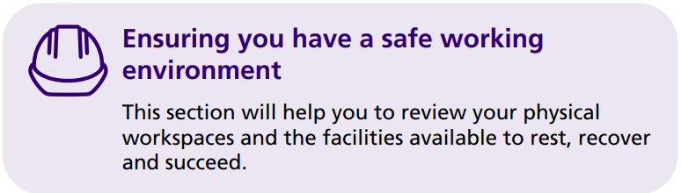
What Section Covers
holding a teamwork environment huddle to begin talking about the team’s work environment
conducting an environment audit to ensure the basics are in place to support wellbeing
having a team conversation about preventing and controlling aggression and violence at work to help team members recognise and know where to go for support
carrying out a team stress risk assessment to help team members identify ways in which to reduce stress in the team
Quick Wins Activities
is your team up to date with any training to ensure safe working and identify workplace risks.
be aware of organisational policies and processes that might already be in place.
More Lengthy Activities
conduct a workplace environment audit
find out if there are local funds/NHS Charities to apply for to enhance staff amenities and identify with team free or low-cost ideas.
feeling safe at work from violence
For more information on ensuring a safe working environment, click on this link
A safe working environment

Slide 11
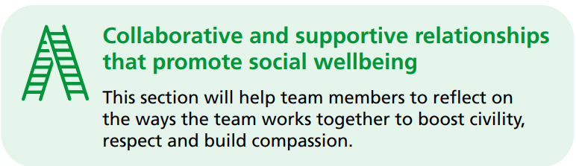
What Section Covers
build team compassion, to encourage team members to show compassion to one another.
celebrate difference to enable team members to appreciate difference and build inclusion.
talk about team civility and respect to help team members recognise and enhance positive interactions with one another.
challenge bias in the team to encourage team members to recognise and challenge bias.
More Lengthy Activities
Build team compassion
Celebrate difference
Talk about team civility and respect
Challenge bias in the team
Quick Wins Activities
Does your team have a wellbeing champion?
Celebrate or mark significant days from different cultures or communities, reflected in the diversity of your team.
For more information on ensuring a safe working environment, click on this link
Supportive relationships

Slide 12
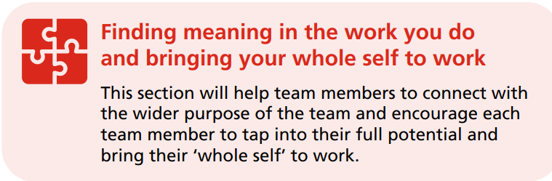
What Section Covers
encouraging team members to bring their ‘whole self’ to work to create a culture of appreciation
creating a culture of appreciation (to encourage team positivity)
tapping into your team’s full potential (to make the best use of the team member’s knowledge, skills & experience)
creating a team member selfie (to enable team members to have a greater understanding of one another)
Quick Wins Activities
Facilitate a session with your team to discover each team member’s personality preferences.
Promote recognition and appreciation in the team
Build in regular opportunities to share successes in the team.
More Lengthy Activities
Create a culture of appreciation
Tapping into your team’s full potential
Create a team member ‘selfie’ – hidden talent, what I do well, how I learn, what makes me happy, 3 words others use to describe me.
For more information on finding meaning in work & bringing whole self to work, click on this link
Finding meaning & bringing whole self to work

Slide 13
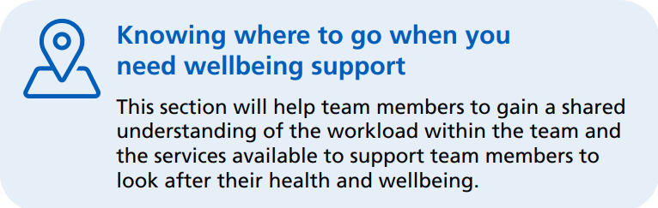
What Section Covers
have a team workload conversation (to enable team members to start to talk about workload and identify ways in which they can support one another)
find out what wellbeing services are available (to enable team members to identify where to go for wellbeing support)
prioritise team workload (to enable team members to prioritise workload)
Quick Wins Activities
share good wellbeing resources with the team – e.g. podcasts, apps, local events or classes.
invite inspiring health and wellbeing champions to come and talk to the team and share their tips and ideas.
More Lengthy Activities
find out what wellbeing support services are on offer.
team workload conversation, re: workload prioritisations.
For more information on knowing where to go for wellbeing support, click on this link
Wellbeing Support

Slide 14
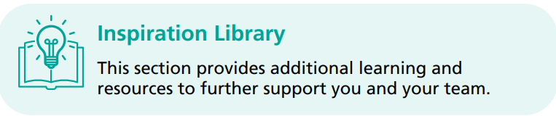
What Section Covers
This section provides additional information and learning to further support you and your team in any of the sections above, including:
websites
training
blogs
videos
Inspiration Library
For more information on the inspiration library click on this link

Slide 15

Review and Revisit Teams Wellbeing Culture and Goals
Repeat the traffic light self-assessment
Review your team’s wellbeing ambition & principles for working together
Check your team’s wellbeing action plan on a regular basis
Celebrate
1
2
3
4

Slide 16

Lancashire & South Cumbria Primary Care Training Hub Bespoke Support
We have a wealth of further resources and training opportunities which can be found on our website.
Please click on this link for details:
Health and Wellbeing Resources – Lancashire and South Cumbria Training Hub
If you need some wellbeing support, please email us on mbpcc.lscthub@nhs.net and our wellbeing team will contact you in confidence, or speak to your Practice
Wellbeing Champion or Practice Manager.

