Slide 1





DATA & BUSINESS INSIGHTS
INFORMATION SESSION
HOSTED BY KENEDIE WILSON
HEALTHCARE ACCOUNT DIRECTOR
Notes:
Introductions – supporting the healthcare sector and primary care employers to utilise data apprenticeships for their development. Working closely with Olivia to support opportunities for you on this call today.

Slide 2


SESSION AGENDA
WHAT IS DATA LITERACY?
PROGRAMME INSIGHTS
IMPORTANCE OF DATA IN THE HEALTH, CARE & VCSFE
BE-SPOKE APPRENTICESHIPS
WHO ARE BALTIC?
HOW CAN THIS BENEFIT YOUR ROLE?
WHAT IS AN APPRENTICESHIP?
SUPPORT, NEXT STEPS AND Q&A SESSION

Slide 3






IMPORTANCE OF DATA IN HEALTHCARE
WHAT IS DATA LITERACY?
Data literacy is the ability to read, understand, create and communicate data as information. It involves skills in analysing and interpreting data, critical thinking, and understanding data sources, quality and context. It enables individuals to draw meaningful insights from data, make informed decisions, and effectively communicate findings to others.
WHY IS DATA LITERACY IMPORTANT?
Enhanced Patient Care
Informed Decision Making
Operational Efficiency
Compliance & Risk Management
Public Health & Research
Technology Integration
BALTIC X DE LA RUE
Notes:
Data literacy in healthcare is crucial for improving patient outcomes, operational efficiency, and decision-making. Here’s why it matters:
Enhanced Patient Care – Clinicians who understand data can better analyze patient histories, predict health risks, and provide more personalized treatment plans.
Informed Decision-Making – Healthcare professionals can make evidence-based decisions by interpreting trends in patient data, reducing errors, and improving efficiency.
Operational Efficiency – Data literacy helps healthcare organizations optimize resources, reduce waste, and streamline processes, ultimately improving service delivery.
Compliance & Risk Management – Understanding data ensures compliance with regulations like GDPR and HIPAA, reducing legal risks and ensuring patient data privacy.
Public Health & Research – Analyzing health trends and epidemiological data allows for better responses to outbreaks, disease prevention, and medical research advancements.
Technology Integration – With the rise of AI, predictive analytics, and electronic health records (EHRs), healthcare professionals must understand data to leverage these tools effectively.
In summary, data literacy empowers healthcare workers to make better decisions, improve patient outcomes, and drive efficiency in an increasingly data-driven industry.

Slide 4









WHO ARE BALTIC?
ABOUT US:
Baltic Apprenticeships are a national provider dedicated to developing tech and digital skills.
As the first to offer a fully tech-focused learning approach, we bring extensive experience to supporting passionate individuals in launching or advancing their careers, while also meeting the needs of modern businesses.
However, despite our faith in technology, we know that teaching life-changing skills needs a human touch.
KEY ACHIEVEMENTS:
Ofsted Outstanding Training Provider
Appointed as an Expert Training Provider by the DfE
Ranked 3rd Best Training Provider in the Country Based on Apprentice Reviews
Sunday Times Best Places to Work
Notes:
Tech and digital specialised training provider, with Data being one of our key routeways.
Ofsted Outstanding and an Expert Provider with the DFE which gives you the opportunity to support us in making reforms across apprenticeships.

Slide 5







APPRENTICESHIPS
WHAT IS AN APPRENTICESHIP?
An apprenticeship is a structured training programme that combines practical on-the-job learning with education. It offers businesses a unique opportunity to develop skilled employees tailored to their specific needs and workplace requirements.
APPRENTICESHIP BENEFITS:
Fix Skills Shortages
Improve Staff Retention
Boost Productivity
Cost-Effective Professional Development
Accelerate Digital Transformation

Slide 6




TECHNICAL TRAINING
APPRENTICESHIP
COMPONENTS
WORKPLACE PROJECTS
The apprenticeship programme is structured into 5 key components.
The technical training modules are designed to develop core skills, practical workplace projects to apply learned knowledge, off-the-job hours for evidence of learning and growth, and a final end-point assessment to successfully complete the programme.
OFF-THE-JOB HOURS
END POINT ASSESSMENT
Notes:
Technical training – Online, 2 days every 6 weeks – teach you the fundamental skills to put back into the workplace.
Workplace projects – Tailored to projects you are doing in work and go towards your workplace portfolio which gets graded at the end of the apprenticeship.
OTJH’S – independent learning done in the workplace and can include research tasks, 1-1, job shadowing or additional self led study
EPA – Professional discussion

Slide 7









DATA & BUSINESS INSIGHTS
ACHIEVEMENT RATES:
95%
PROGRAMME OVERVIEW:
LEVEL 3 APPRENTICESHIP
Data enables businesses to make informed decisions, enhancing overall efficiency and driving company growth & innovation. To harness the full potential of data and support strategic business choices, your employees must possess data skills that empower them to extract meaningful insights from complex datasets.
Our Level 3 Data & Business Insights programme builds data management, analysis, visualisation and communication skills that support immediate business goals while building long-term resilience, positioning your business for sustained growth in a data-centric world.
PASS RATE
PROGRAMME DURATION: 15 MONTHS
TRAINING DELIVERY: ONLINE DELIVERY
94%
PROGRESSION: LEVEL 4 DATA ANALYST
CORE MODULES:
HIGHER ACHIEVEMENT RATE
MODULE 1
MODULE 3
MODULE 5
THE POWER OF DATA
PRESENTING ACCURATE INSIGHTS
BUSINESS ANALYSIS USING POWER BI
99%
MODULE 2
MODULE 4
MAKING DATA-DRIVEN DECISIONS
CONFIDENT DATA COMMUNICATIONS
OF LEARNERS ACHIEVE ON TIME
Notes:
THE POWER OF DATA - Ensure your team understand the data at their disposal. This hands-on course ensures participants understand the critical importance of data in their role and the wider digital world. We prepare learners with the foundational knowledge that is required to begin confidently handling data, organizing information, and drawing insights that support smarter decisions. Over two days, learners will:
Understand business data sources and their purpose in operations
Confidently select, compare, and evaluate datasets for relevance and limitations
Become familiar with handling data in formats like CSV, Excel, and JSON
MAKING DATA-DRIVEN DECISIONS - This course empowers your team to work confidently with data, ensuring it’s secure and organised. Participants will learn to spot trends, create clear documentation, and use tools that simplify teamwork. Using real-world examples, employees will gain the analytical and critical thinking skills required to make informed decisions that contribute to overall business success. Over two days, learners will:
Understand ethical data handling, responsible usage, and societal impact
Learn data tools for efficient storage and organisation
Analyse datasets to identify patterns and gain insights into business performance
PRESENTING ACCURATE INSIGHTS - Accurate data empowers smarter decisions – turning insights into impactful business strategies. Participants will learn to clean data, check for errors, and ensure quality with practical tools and techniques. Learners will create impactful charts, selecting the right chart type to best represent specific data, making insights easy to understand and share. Over two days, learners will:
Understand how poor data quality impacts analysis
Learn data validation techniques and best practices
Explore written and visual methods to effectively communicate data insights
CONFIDENT DATA COMMUNICATIONS - Data storytelling transforms complex insights into clear, actionable visuals. This course empowers participants with the ability to turn raw data into compelling narratives, bridging the gap between analysis and meaningful business decisions. Learners will understand how to communicate data to both technical and non-technical stakeholders and gain practical experience using dashboards and communication tools. Over two days, learners will:
Craft engaging data stories for stakeholders
Build skills to create a dashboard for visualising key metrics and trends
Explore data presentation techniques and adapt communication
BUSINESS ANALYSIS USING POWER BI - Incorporating elements of previous modules, this course ensures learners can put theory into practice. Learners will explore predictive analysis and use real-world data to bring projects to life – identifying business needs, assessing data trends, and presenting complex data simply, using tools like Power BI to create meaningful dashboards. Over two days, learners will:
Explore effective report and dashboard components, including design and key metrics
Gain the ability to plan data projects, define goals, and identify sources
Develop skills in dashboard design, importing data, and creating interactive visualisations with filters and KPIs.

Slide 8




CORE MODULES
Our core skills modules are delivered in 2-day blocks via our online classroom. Each module lasts 15 hours and is delivered virtually by our expert coaches.
BE-SPOKE
ESSENTIAL MODULES
Our essential modules are self-study, mandatory courses that provide employees with the foundational skills they need to become versatile and effective
professionals in today’s digital landscape.
DESIGNED BY YOU. DELIVERED BY US.
Be-Spoke is a revolutionary tool that allows you to design your own apprenticeships, tailored to your industry's specific challenges and your company's unique needs.
With Be-Spoke, you have the power to customise multiple aspects of our apprenticeships from start to finish – ensuring a maximum return on investment and offering a level of personalisation never seen before in the apprenticeship sector.
EXPERT MODULES
Our expert modules are delivered through live workshops by our expert coaches. These cover industry-recognised tools and technologies, and some have commercial certifications attached to them.
BE-SPOKE MODULES
You will choose two be-spoke modules to bolt onto the apprenticeship programme. These are specific to your sector and are designed to take the programme
to the next level.

Slide 9
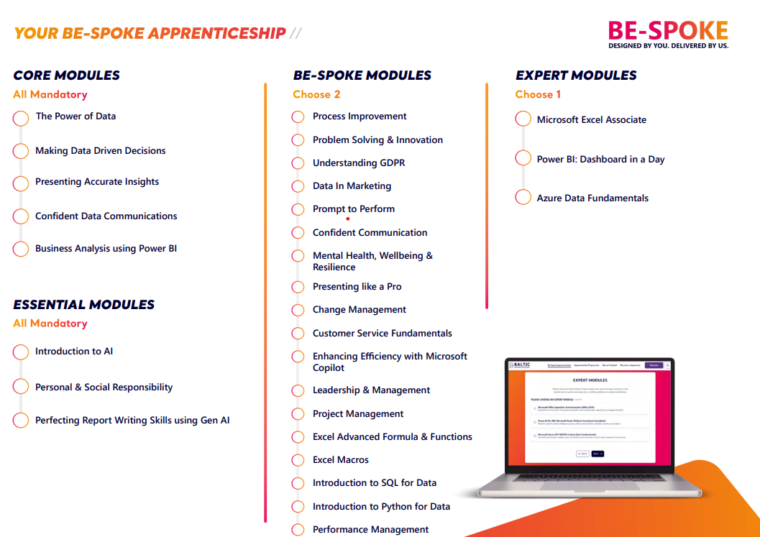

Slide 10


INTRODUCTION TO AI
Brand-New Course Accessible to All Apprentices
Introduction to AI builds the knowledge and technical skills required to contribute to the workforce of the future. This comprehensive 3-part course empowers learners with a foundational understanding of AI principles, applications, and ethical considerations.
We teach traditional core concepts and provide hands-on experience using generative AI tools for project writing, creative tasks, and data retrieval. Learners will become familiar with neural networks, generative AI, and data protection regulations, ensuring they can apply knowledge to drive company efficiency and solve business problems.
Over the course, participants will:
Have a clear understanding of the scope of available AI categories, from reactive machines to generative AI, and identify real-world examples of each model.
Use generative AI models, such as ChatGPT & Google Gemini, efficiently and effectively, and learn best practices to improve machine output.
Build critical thinking skills, and learn verification techniques, to ensure all information collected from generative AI models is correct, fair, and compliant with data regulations.
Critically examine the ethical considerations surrounding AI usage and learn how to avoid potential pitfalls, integrating AI safely and responsibly.

Slide 11








HOW CAN THIS FIT YOUR ROLE?
FINANCE & PERFORMANCE
MARKETING
MANAGEMENT
PEOPLE DIRECTORATE
PROJECT SUPPORT
OPERATIONAL & STRATEGIC
DATA & TECHNOLOGY
Notes:
GP’s - Analyse large datasets to spot trends in patient outcomes and treatment effectiveness, Identify high-risk patients more easily (e.g., those likely to be re-admitted or deteriorate), Use data to ensure timely follow-ups, screenings, and medication reviews. Spend less time hunting through records, more time with patients.
Finance & Performance – examples could include Finance Analysts using financial data to track spending, forecast budgets and improve cost efficiency. To help analyse healthcare demand and allocate funding to different primary care networks accordingly.
Project Support - Build dashboards to track KPIs, milestones, and timelines without relying on spreadsheets, Monitor progress instantly instead of chasing teams for manual updates. Identify delays, bottlenecks, or risks before they escalate. Map out current processes and use data to suggest improvements. Become more valuable in any change, PMO, or transformation team. Track outcomes of a service redesign, Analyse survey or patient feedback data, Support business case for digital rollout (e.g., new e-referral system)
Data & Technology – Health Data Analysts, interpret healthcare data to identify trends, improve patient outcomes and optimise hospital resources. BI Analysts, use data visualisation tools to generate reports that inform hospital management and policy decisions. Health Informatics Specialists, manage and analyse electronic health records to enhance clinical decision making.
Operational – Clerical Officer, Admin Assistant, receptionists - for administrative efficiency and workflow optimisation, up to date EHR’s, appointment scheduling, performance and productivity tracking, patient and staff communication. – Reduce
Management – use data for performance monitoring and improvements across the primary care network by tracking KPI’s, for workforce planning and management, financial management and budgeting and patient flow and capacity planning.
People – data is used to predict workforce shortages, ensure adequate staffing levels to meet demand, identify staff turnover and identify skills gaps through data to ensure targeted training programmes.

Slide 12

BOOSTING EFFICIENCY THROUGH RELIABLE DATA HANDLING
DELIVERED BY CRAIG ADDISON
ENTERPRISE DATA COACH
Notes:
Hi everyone — and welcome! Today, we’re going to look at how your skills as a future data technician will directly support GP surgeries and primary care teams.

Slide 13
Role of Data
in Primary Care
K3 – How to collate and format data
S8 – Apply cross checking techniques
Notes:
Primary care relies heavily on data — things like appointment records, vaccination data, staff rotas, patient recalls, and more. If that data isn’t accurate, up to date, or well formatted, it can cause delays and mistakes.
This microteach focuses on two key areas from your apprenticeship:
K3: learning how to collate and format data to NHS standards
S8: applying cross-checking techniques to find and fix issues in data
By developing these skills, you’ll make a big difference — helping GP practices work more efficiently and improving care for patients."

Slide 14
K3 – Collate & Format Data to Standards
1
3
2
CONTEXT
EFFICIENCY BENEFITS
EXAMPLE
Pulling data from EMIS, SystmOne, or AccuRx and formatting it for QOF, IIF, or local ICB reports
Using consistent templates (e.g., NHS Digital specs, SNOMED codes)
Creating clean, sharable Excel or CSV reports for internal and external use
Saves admin time: less manual cleanup of reports
Reduces risk of rejected submissions (e.g., QOF or Enhanced Services)
Ensures better collaboration with PCNs, ICBs, and commissioners
A practice manager uses formatted data from SystmOne to easily generate a hypertension register report for IIF claims.
BALTIC X DE LA RUE
Notes:
Let’s start with K3: understanding how to bring data together and format it to the right standard.
In a GP practice, you might need to gather patient data from systems like EMIS or SystmOne and then format it for reports — like QOF submissions, IIF targets, or even just simple spreadsheets for your practice manager.
You’ll learn how to:
Organise messy data into a usable format (like CSV or Excel)
Use NHS coding standards — for example, SNOMED codes
Make data easy to read, share, and upload
Why does this matter? Because if the data isn’t formatted properly, reports get delayed or rejected. But if you get it right, the team can act on that information quickly — for example, running a successful flu jab campaign with the right patient list, first time."

Slide 15
S8 – Cross-Checking for Accuracy & Insight
1
3
2
CONTEXT
EFFICIENCY BENEFITS
EXAMPLE
Verifying patient lists (e.g., flu jab eligibility, recalls, LTC reviews)
Spotting errors in appointment data (e.g., mismatched codes, DNA tracking)
Checking that dashboards reflect actual performance (e.g., access metrics)
Prevents inaccurate claims or reporting
Supports safe patient care (e.g., no missed follow-ups)
Helps identify trends or issues earlier (e.g., increasing DNAs or drop in health checks)
A data technician spots duplicate patient entries on a diabetes register, avoiding over-reporting and ensuring accurate care plans.
BALTIC X DE LA RUE
Notes:
Now, let’s talk about S8: checking data to make sure it’s accurate and suitable for its purpose.
Imagine you’re asked to run a report on all patients who’ve missed their diabetes checks. If the data has duplicates, missing info, or wrong codes, it could give the wrong results — which means patients might not get the care they need.
You’ll learn how to:
Spot errors in reports (like missing NHS numbers or duplicate patient entries)
Compare lists from different sources to check for consistency
Make sure the data you’re giving the team is clean and trustworthy
This kind of cross-checking saves time, avoids mistakes, and helps keep patients safe.

Slide 16
Summary
Any Questions?
K3 – How to collate and format data
S8 – Apply cross checking techniques
Notes:
To wrap up: as a data technician apprentice, you’re not just doing admin — you’re becoming a key part of the primary care team.
With K3, you’ll help make sure the data is organised and properly formatted for NHS use — whether that’s for performance targets, audits, or health campaigns.
With S8, you’ll help prevent errors, make reports more reliable, and ensure the right data reaches the right people at the right time.
These skills save the practice time, reduce stress for staff, and ultimately lead to better patient care. That’s the kind of real-world impact you’ll be making on this apprenticeship — and it all starts with good data handling.

Slide 17
SUPPORT & COMMITMENT
1
3
2
YOUR ACCOUNT MANAGER
YOUR COACH
PROGRESS REVIEWS
Line Managers will receive personal support through their dedicated Account Manager.
Our Account Managers are the main point of contact for employers to maximise the value of the apprenticeship.
Apprentices will receive one-to-one coaching and dedicated support. They will also have tailored support sessions to nurture their development throughout the programme.
Every 12 weeks, you and your apprentice will complete a progress review with your Coach to create action plans discuss progress so far.
We expect attendance on review sessions with your learners and their Coach, which take place approximately every 12 weeks.
These review sessions present an opportunity to provide feedback on your apprentice’s strengths and development areas, as well as keep in touch with their training outcomes, portfolio projects and deadlines.
BALTIC X DE LA RUE
Notes:
Workplace projects -

Slide 18
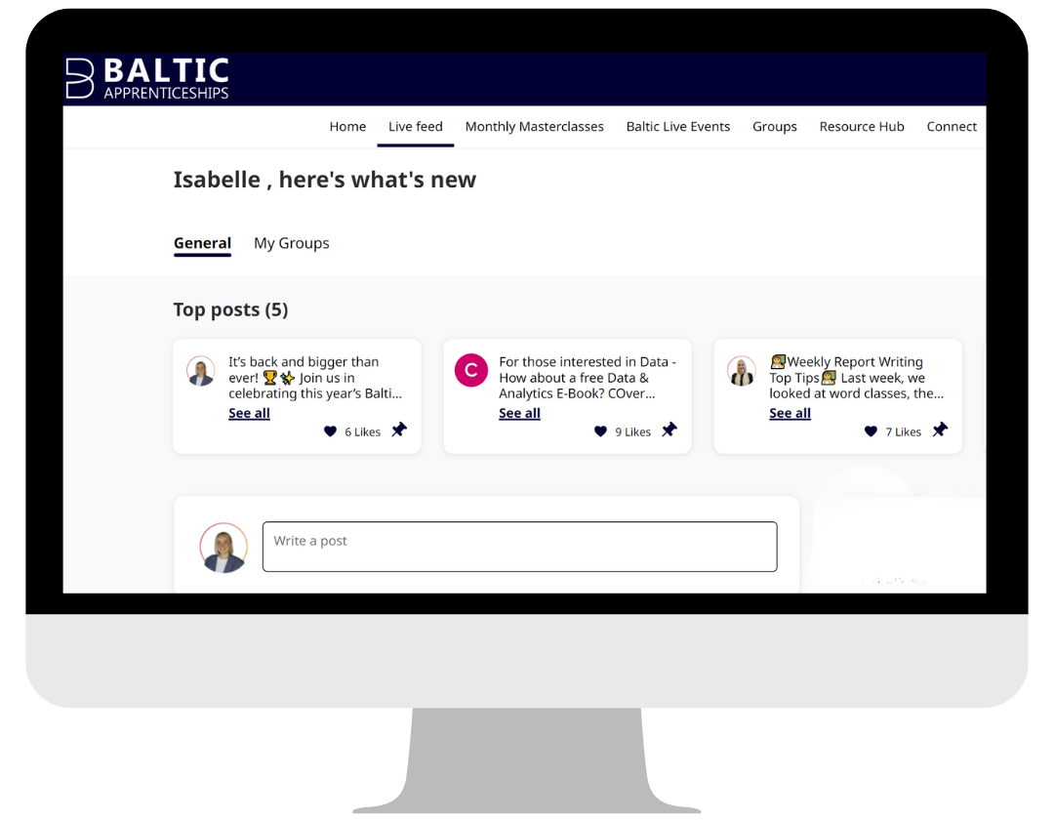
BALTIC COMMUNITY
The Baltic Community is a unique platform with a mission is to build a sense of community for our apprentices, providing a space to connect with other learners, access support, and make the most out of their apprenticeship journey.
On the community, learners can access various skills development resources, tailored training courses, book Baltic Live events, and share best practices with other apprentices.
Our Community Hub is also a great way for coaches to stay connected, interacted and engaged with learners more frequently.

Slide 19
APPRENTICESHIP
LEVY FUNDING
In England, large organisations with an annual salary bill of over £3 million pay into the Apprenticeship Levy.
This acts as a pre-paid funding pot to use on apprenticeship training for new and existing employees. By effectively utilising your Apprenticeship Levy your organisation will experience benefits such as improved employee training, expanded apprenticeship opportunities, and increased employee satisfaction.

Slide 20
APPRENTICESHIP
FUNDING FOR SMES
In England, there are different amounts of funding available for apprenticeships.
If your apprentice is aged 16-21, the government will fund 100% of the programme cost. For apprentices aged 22+, the government will fund 95%, with you as the employer paying the remaining 5%.
HIRING INCENTIVES
You may be entitled to a £1000 grant for supporting an apprentice
You’ll pay no National Insurance contributions for any apprentice under 25
Any non-levy paying employers and can apply for a levy transfer to cover 100% of the tuition fee (course cost). This is never guaranteed, but to date has been very successful. If a levy transfer can-not be secured, then non-levy payers will only pay 5% of the tuition (the Government pays 95%). The NHSE NW Levy Team will support Employers with Levy Transfer requests - your Training Hub will provide guidance on how to start this process off.
Notes:
Throughout the apprenticeship, learners must complete apprenticeship related work and upload this to their time log.
Roughly 150 hours should come from training from yourselves within the workplace
Baltic will make up roughly 315 hours with apprenticeship delivery and project work.

Slide 21
North West Primary Care Training Hubs
Cheshire and Merseyside
cmicb-wi.cmthapprenticeships@nhs.net
www.cmthub.co.uk
Greater Manchester
Carla Slater - Senior Apprenticeships Coordinator
Carla.slater1@nhs.net
www.gmthub.co.uk
Lancashire and South Cumbria
Olivia Murphy - Apprenticeships Manager
mbpcc.apprenticeships@nhs.net 07735161775
www.lscthub.co.uk
Your Training Hub is available to help with apprenticeship queries and applications, including:
Local Course options
Levy Transfer requests
Procurement contracts
Apprenticeship queries
Training Hub Teams also support various development/strategic projects for their area and the North West, to collaboratively help develop and promote apprenticeship options for Health and Care

Slide 22





NEXT STEPS
Your recruitment consultant will introduce themselves
Your employee is inducted onto the apprenticeship within 28 days
We send access to the Baltic Hub & Data Capture Form to complete
A skill scan is completed to ensure the programme is suitable
We conduct a screening call to assess eligibility
Notes:
**REMEMBER TO SUMMARISE BEFORE DISCUSSING NEXT STEPS**

Slide 23

kenedie.wilson@balticapprenticeships.com
07463373811
THANK YOU
ANY QUESTIONS?

