Slide 1
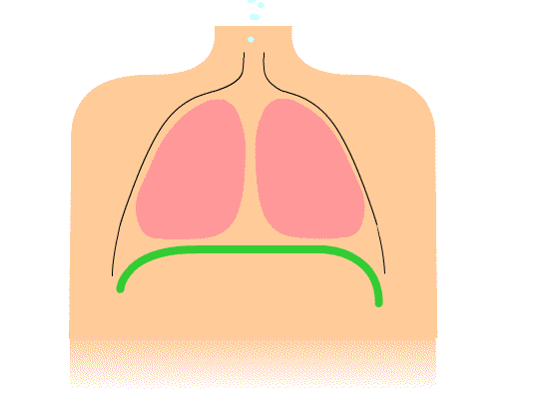
Measuring Vital Signs
By Elizabeth Smith

Slide 2
Learning Outcomes
In today’s session you will learn:
How to safely take a set of vital sign’s including:
Respiratory Rate
Oxygen Saturations
Blood Pressure
Pulse Rate
Level of Alertness
Temperature

Slide 3
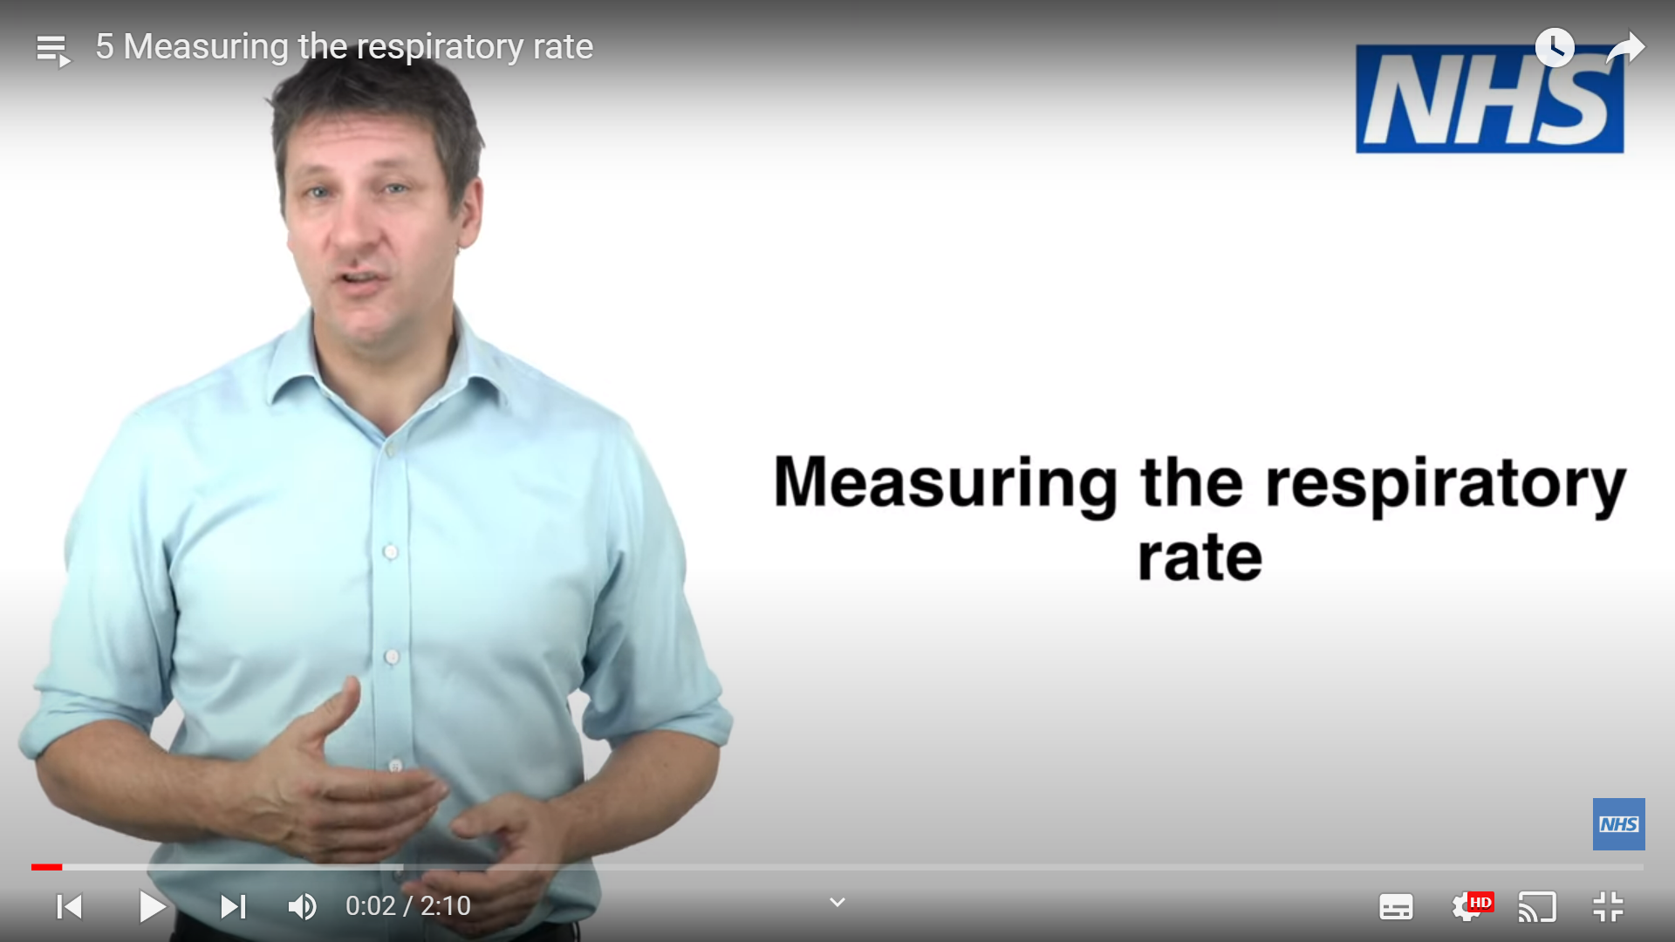
Respiratory Rate
Respiratory rate is the number of breaths in 1 minute.
What is a normal Respiratory Rate in Adults?
A normal respiratory rate is 12-20 breaths per minute.
5 Measuring the respiratory rate - YouTube

Slide 4
Oxygen Saturations
Oxygen saturation is the level of oxygen in the blood.
What are normal Oxygen Saturations in an adult without a Respiratory condition?
A normal oxygen saturation is 96-98%.
What are normal Oxygen Saturations in an adult with a Respiratory Condition?
If instructed by a Doctor or Lung Nurse, we can accept Oxygen Saturation levels of 88-92% in people with a Respiratory condition.
6 Measuring oxygen saturation - YouTube

Slide 5
Blood Pressure
Blood pressure measures the force of blood exerted on the arterial wall.
There are 2 readings that comprise a blood pressure reading. The first number is the systolic pressure which indicates the pressure when the heart is contracting. The second number is the diastolic pressure which indicates the pressure when the heart is relaxing.
A normal systolic blood pressure is 111-219mmHg (according to the NEWS 2 chart).
7 Measuring blood pressure - YouTube

Slide 6
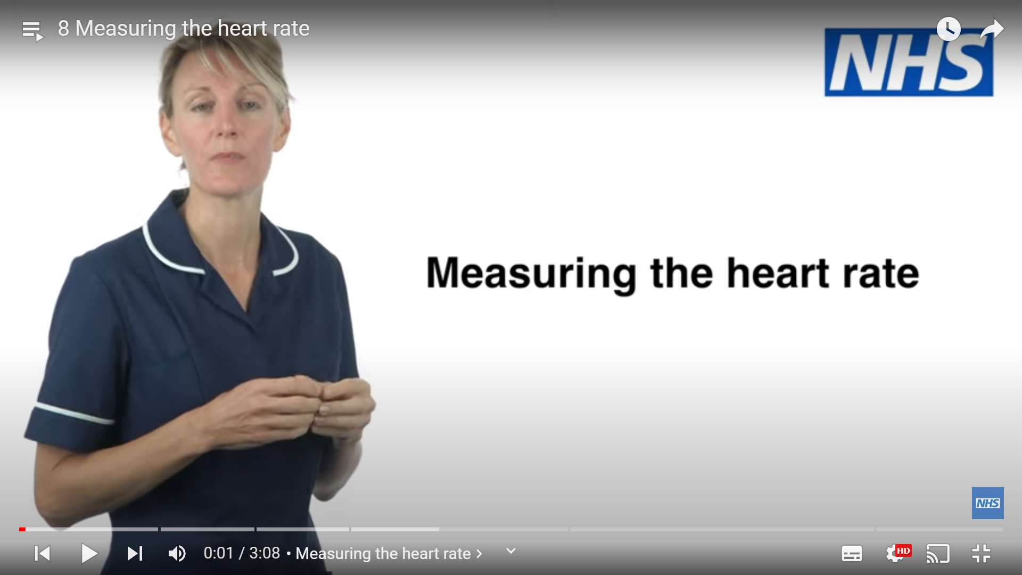
Pulse Rate
Pulse rate, also known as heart rate, is the number of beats measured in 1 full minute.
What is a normal pulse rate/heart rate in an adult?
A normal pulse is 51-90 (according to the NEWS 2 chart). It is important to know whether a resident has any underlying heart conditions and whether they are on any medication that can lower the pulse.
8 Measuring the heart rate - YouTube

Slide 7
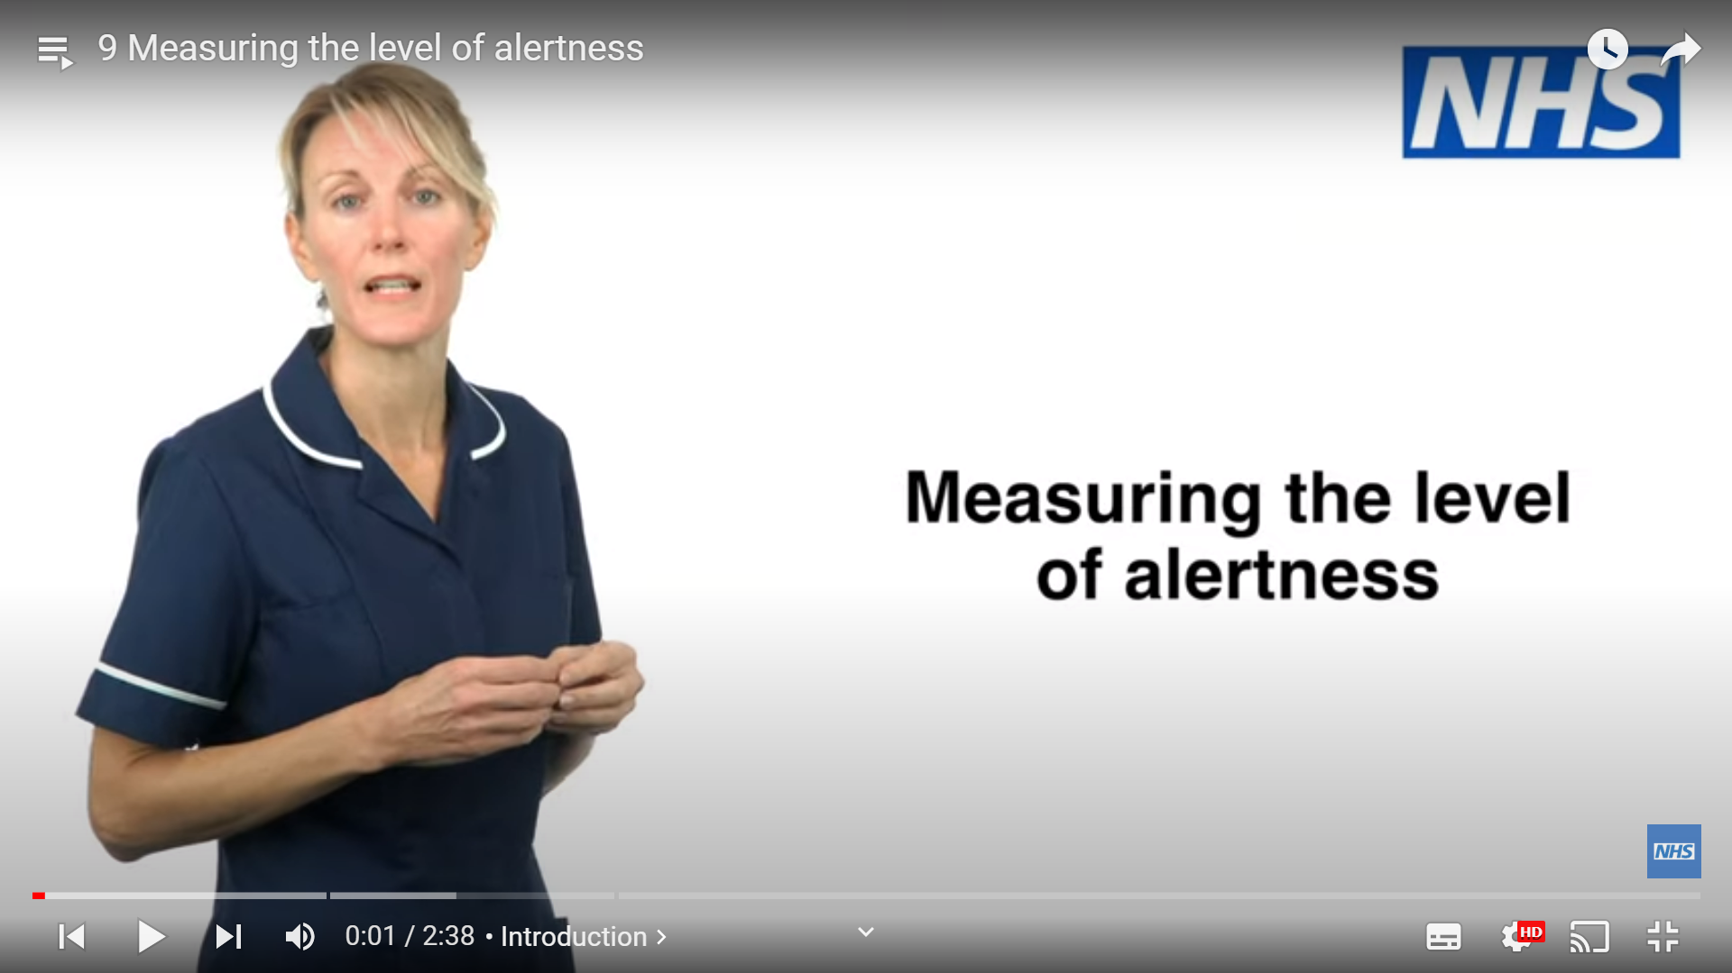
Level of Alertness
Level of alertness is measured in the following way:
A ALERT | C NEWLY CONFUSED | V VOICE | P PAIN | U UNRESPONSIVE
9 Measuring the level of alertness - YouTube

Slide 8
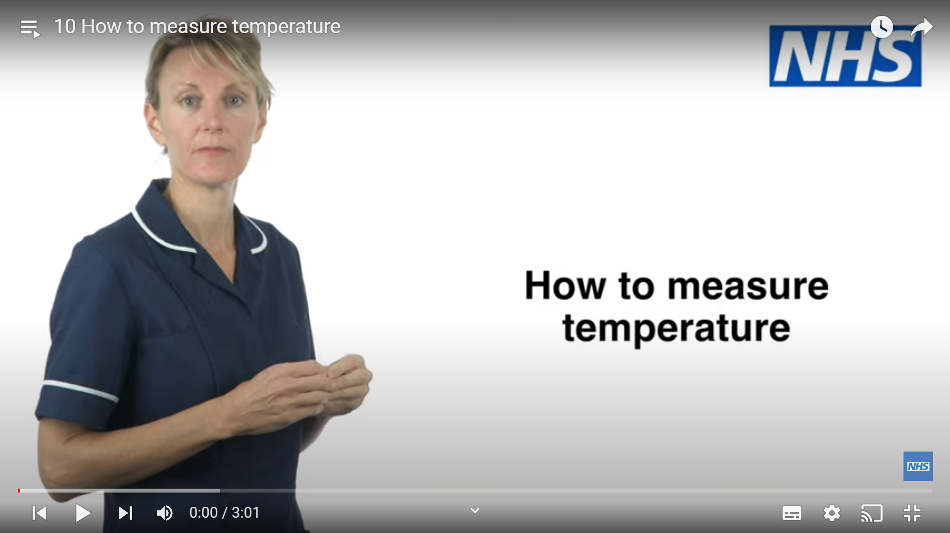
Temperature
Thermometers come in various forms, so it is important to know how to use the model that is within your workplace.
A normal core temperature is between 36.1-38.0C.
10 How to measure temperature - YouTube

Slide 9
NEWS 2 and RESTORE 2
The National Early Warning Score (NEWS2) is a system for scoring the physiological measurements that are routinely recorded at the resident's bedside. Its purpose is to identify acutely ill residents, including those with sepsis.
It advocates a system to standardise the assessment and response to acute illness.
RESTORE2™ is freely available to download. However, before using, you must ensure your staff have received appropriate training to use the tool safely. This includes (as a minimum) staff having completed physical observation training and competencies as well as either online training in NEWS2 and deterioration, or equivalent face to face training. The organisation must have processes in place to maintain and calibrate observation equipment. We strongly recommend that you frequently audit compliance and outcomes when using RESTORE2™. The organisation implementing and using RESTORE2™ has sole responsibility to ensure its appropriate use.

Slide 11
References and Useful Links
Basic observations station - OSCE (simpleosce.com)
Health Observation Lecture: Measuring and Recording the Vital Signs (nursinganswers.net)
Sample-policy-information-on-clinical-observations.docx (live.com) Skills for care sample policy
Restore 2 RESTORE2™ Training and resources :: Hampshire and Isle of Wight ICS (hantsiowhealthandcare.org.uk)

