Slide 1


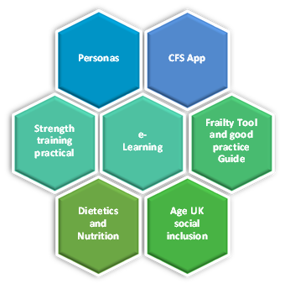

Frailty Speed Dating Training
Workbook 2024
Train the Trainer V2.0

Slide 2

Speed Dating Frailty Training
Following the end of the formal workshops for the Engineering Better Care L&SC in October 2023 the programme has linked in with the ICB led group ‘Action on Frailty’ chaired by Dr John Miles and Ms Samantha Wallace
The group has 5 sub-Task & Finish Groups, in which the first for the training took place last Friday (12th January)
Following the NHSE guidelines published 19th December 2023
  Proactive care: providing care and support for people living at home with moderate or severe frailty
  The task and finish groups have used this to steer the outputs
NOTES:
__________________________________________________________________________________________________________________________________________________________________________________________________________________________________________________________________________

Slide 3
Train the Trainer Model
Empowering Subject Matter
Learning Space Design
Basic Facilitation (stations)
Facilitate learning experiences on a variety of Frailty topics
E-Learning
On the Way to becoming a frailty identification & assessment expert
Competency Levels
Knowledge Levels
Resources (packs provided)
Skill set Levels
Personas
Nutrition & Hydration
Strength Training
Social Inclusion
Bone Health
CFS APP
Pre-Training Questionnaire
Pre & Post-Training Questionnaire
Certificate of attendance
On-going CPD hours
NOTES:
__________________________________________________________________________________________________________________________________________________________________________________________________________________________________________________________________________

Slide 4
Who you will need
Who you need to deliver
Deliver
Frailty Clinical Specialist (ACP/Medic/TACP/Frailty Nurse etc) – Lead Relevant to area
Therapy - Lead
OT/Physio Assistant – Strength Training
Age UK – Social Inclusion
Dietician – Nutrition and Hydration/Bone Health
Mental Health – Mood
2 other members of the team to help co-ordinate
Admin/Improvement/Programme support
ADD areas of cover
Who should attend
Attend
Community Services
INT leads
Community Therapies
Primary Care
PCN teams
Place reps
Social Care
Hospices
Mental Health
Faith Groups/leads
*** Patient focus groups?**** Via Age UK
Voluntary sector (localisation)
How long does it take
Time
2 Hours
Pre and post evaluation to measure impact
Self-Audit tool
Data packs baseline from Aristotle
Workbook packs
Posters
Good Practice Guidelines
Pre-planning time etc. set up time
Planning & Organisation
Plan
Pre-planning time
Admin to support booking rooms etc
Improvement/Programme Management
Venue
Pre/Post evaluation and continuous measurement

Slide 5
Speed Dating Frailty Training
The ambition for this training is that all 44 PCNs across Lancashire and South Cumbria will complete the training by March 2025 via a Train the Trainer model for scale and spread.
We aim to offer to all staff in Primary, Secondary and Third sector who work and care for people with Frailty.
The comprehensive 2-hour Training consists of 10 minutes sessions. Each session we are aiming for the training to be fun and memorable.
Delivering the training will be TACP, Age UK, Physio, INT Co-Ordinator and Medical oversight
NOTES:
__________________________________________________________________________________________________________________________________________________________________________________________________________________________________________________________________________

Slide 6
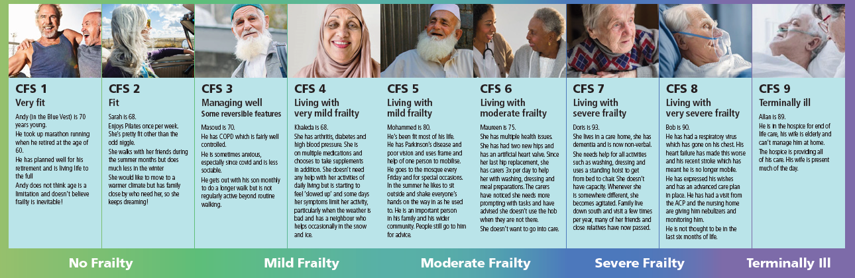
Personas
NOTES:
__________________________________________________________________________________________________________________________________________________________________________________________________________________________________________________________________________

Slide 7
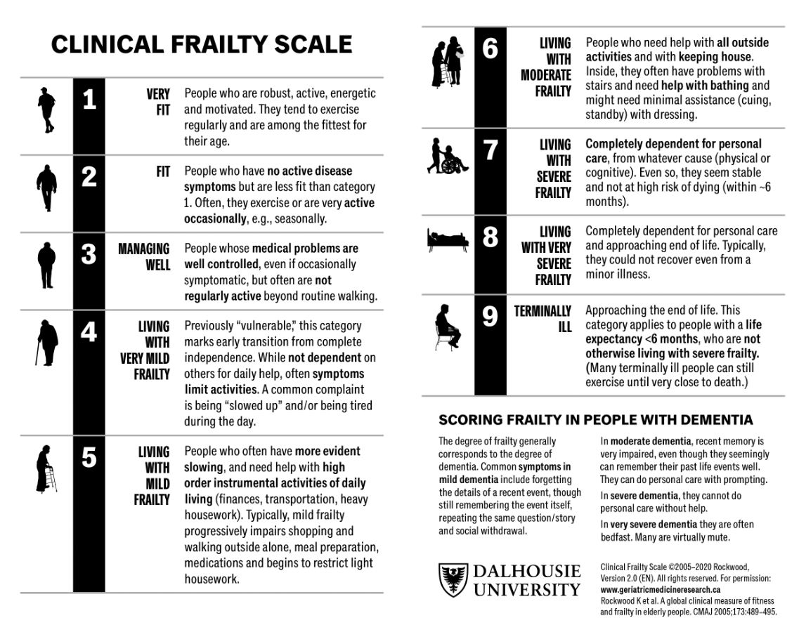
Clinical Frailty Scale
NOTES:
__________________________________________________________________________________________________________________________________________________________________________________________________________________________________________________________________________

Slide 8


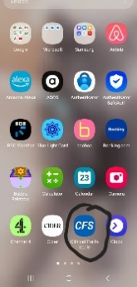
CFS APP
How to Download the CFS app to your phone
Open the app store on your smart phone!
The app will automatically download to your smart phone or tablet.
NOTES:
__________________________________________________________________________________________________________________________________________________________________________________________________________________________________________________________________________

Slide 9
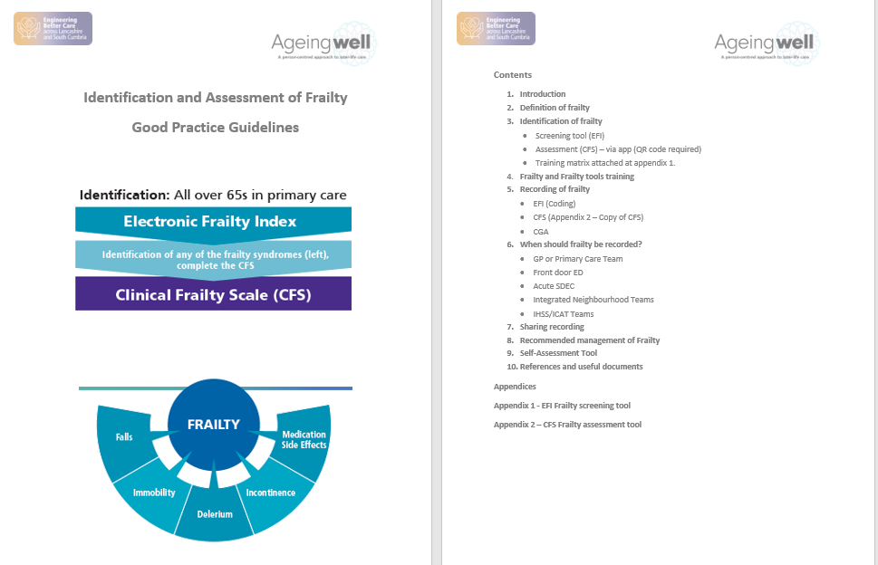
E-Learning & Good Practice Guide
NOTES:
__________________________________________________________________________________________________________________________________________________________________________________________________________________________________________________________________________

Slide 10
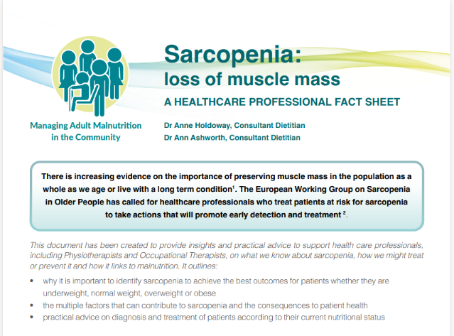
Strength Training
NOTES:
__________________________________________________________________________________________________________________________________________________________________________________________________________________________________________________________________________

Slide 11

Nutrition & Hydration
NOTES:
__________________________________________________________________________________________________________________________________________________________________________________________________________________________________________________________________________

Slide 12
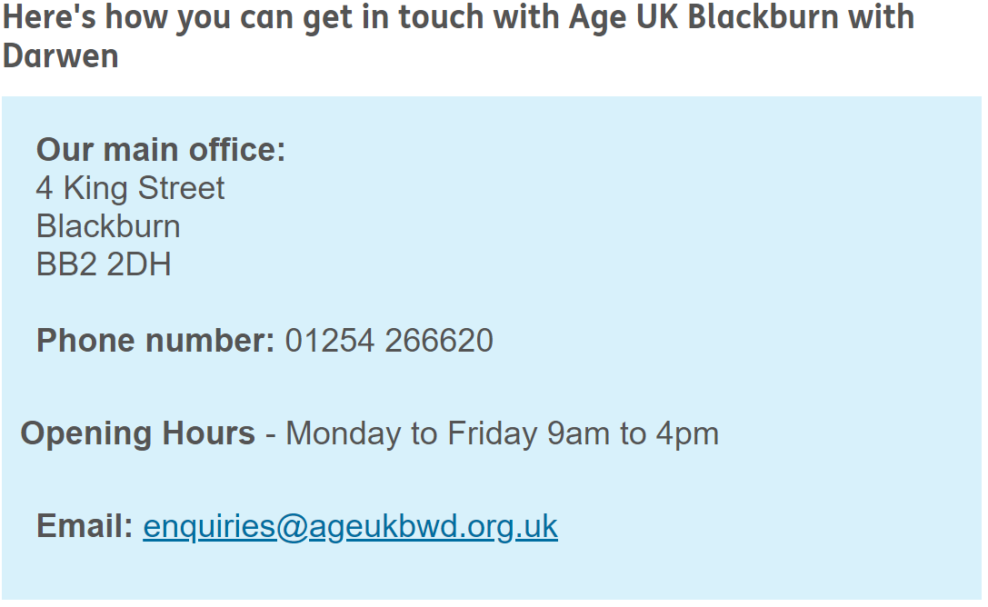

Age UK Social Inclusion
NOTES:
__________________________________________________________________________________________________________________________________________________________________________________________________________________________________________________________________________

Slide 13
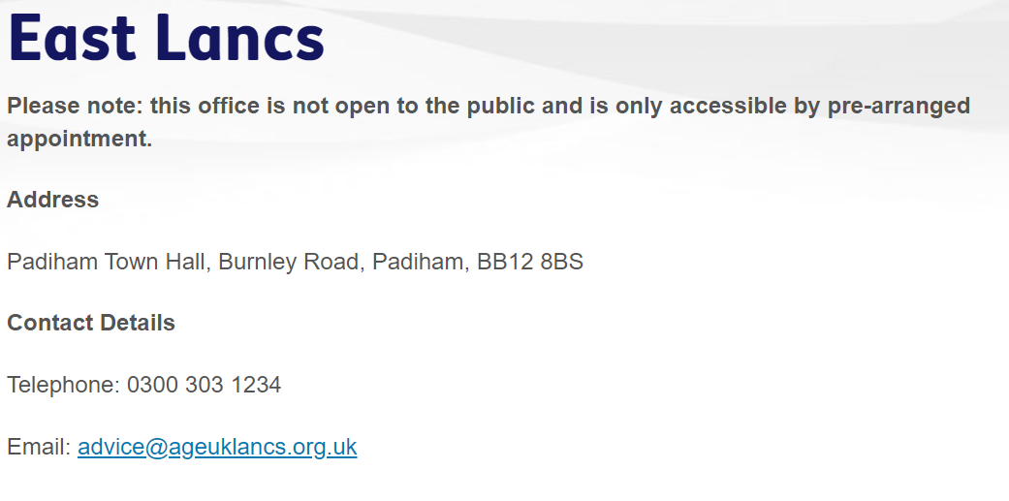

Age UK Social Inclusion
NOTES:
__________________________________________________________________________________________________________________________________________________________________________________________________________________________________________________________________________

Slide 14
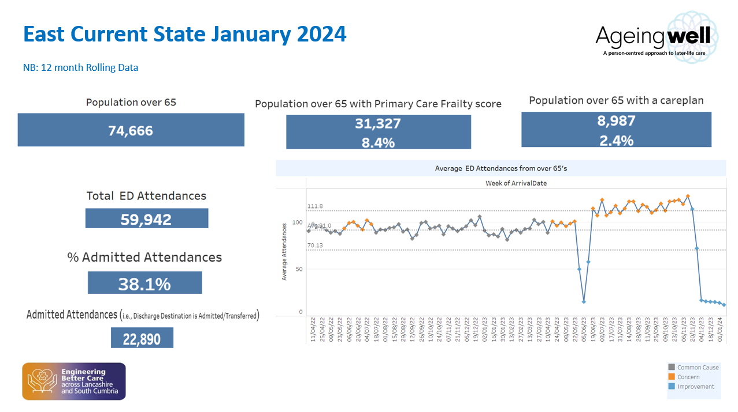
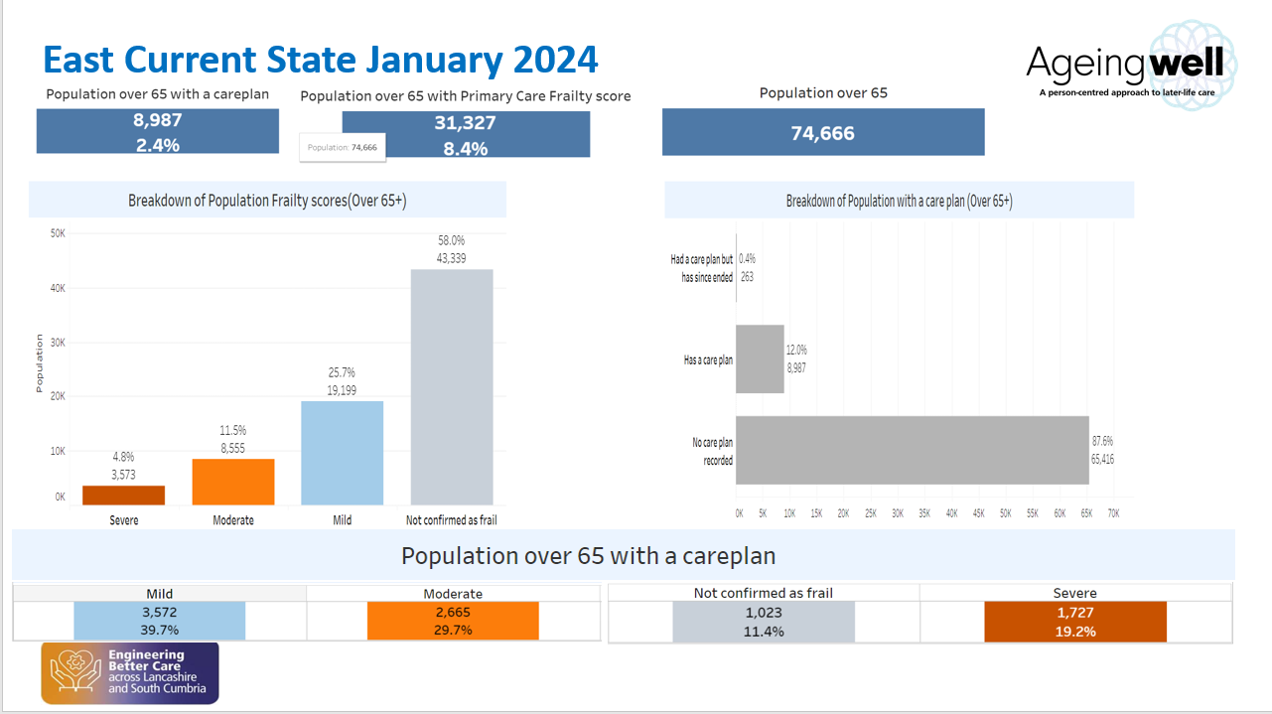
Data Pack
We can support by producing a current state data pack that includes:
  Secondary Care and A&E attends by CFS, Presenting Condition
  Care Plan and CFS data by PLACE, PCN or Practice Level
  Admittances data, by CFS and LOS
NOTES:
__________________________________________________________________________________________________________________________________________________________________________________________________________________________________________________________________________

Slide 15
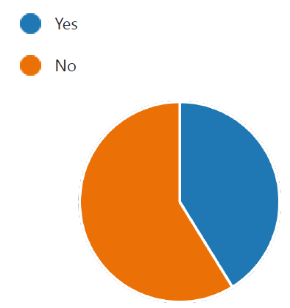
Why the training?
We can see by the results from the pilot areas in East Lancashire that staff feel more confident in identification and assessing people who live with frailty, along-side understanding ongoing opportunities for input. (January & February 2024)
Pre and post questionaries to over 75 staff
​Question | Pre-Training​ | Post Training ​ | Improvement ​
Understanding of Frailty​ Please rate your understanding of frailty pre- training | 6.06​ | 8.39​ | 2.33 (38.5%)​
Confidence using the CFS​ How confident are you identifying frailty correctly using the CFS | 5.94​ | 8.33​ | 2.39 (40%)​
Identifying Interventions Once a level of frailty has been identified rate your knowledge of accessing the best interventions for this individual ​ | 5.65​ | 8.06​ | 2.41 (42.5%)​
Proportion of staff who have completed the Skills for Health e-Learning Module
Have you completed the e-learning on frailty tier 1&2 (on the learning hub
ELHT or NHS England e-learning for Health?

