Slide 1
Assistant Practitioner (FdSc) Degree Apprenticeship Programme Overview & Recruitment Timelines March 2026 September 2026 TBA

Slide 2
Recruitment Timeline for DA-Assistant Practitioner March 2026

Slide 3
Assistant Practitioner Role
Assistant Practitioners
Flexible skill mix
Work with a range of registered practitioners
No requirement for external placements
Can administer medications (dependant on organisational policies and procedures)
Not registered
Advanced entry into other Pre-registration health professional programmes
Meet the needs of your service across all health and social care settings.
Nursing Associates
Bridges gap between health care assistant and registered nurses
Training requires external placement hours
NMC registration
Can administer medications
Advanced entry into Pre reg Nursing degrees.
Designed to develop nursing workforce across all nurse led settings.

Slide 4
Entry – Eligibility Criteria
Recruitment manager to attend university interview for internal/external applicants (Arranged via MS Teams).
Math and English due to Government changes around apprenticeships, from February 2025 are not a requirement. This will be an employer decision if candidate needs to study Functional Skills Level 2, alongside their Foundation Degree (if not already attained) a consideration for candidates who may wish continue their study on a registered undergraduate BSc.
Level 3 qualification in Health & Social Care (equivalent) BTEC National Diploma, NVQ is desirable or previous experiential healthcare experience 3-5 years.
Employer to check and have visual sight of hard copies of certificates, before interview with UCLan staff to confirm qualifications.
Contract of employment is for minimum duration of the apprenticeship.
Minimum contracted hours – 30 hours per week.
Learner must have appropriate IT equipment especially if an on-line learner.

Slide 5
Entry – Eligibility Criteria continued
Cost of the Apprenticeship is covered by employer.
Commitment to attend University one day per week – Hybrid delivery (F2F or online) for two years (equates to 21 months on programme with 3 months to complete End Point Assessment (EPA).
The salary is in line with NMW requirements
The apprentices must not be enrolled on to another apprenticeship course.
The apprentice must have the right to work in England and spend at least 50% of their working hours in England and must have been ordinarily resident, minimum period of three years prior to commencement of the course.

Slide 6
Course Overview
1 day off the job learning (Minimum 6 hours per week)
Learner employed for minimum of 30 contracted hours
2-year programme delivered across 3 semesters
Core and ‘Pathway’ modules specific to service need or profession specific (Varies for March & September cohorts)
Inclusive admissions criteria
Flexible delivery via ‘Hybrid’ (Face to Face and on-line)
Learner will need an appropriate mentor in practice, to monitor their development and attend 12-week tripartite review meetings, along with the Apprenticeship Educator.

Slide 7

Hybrid Delivery

Slide 8
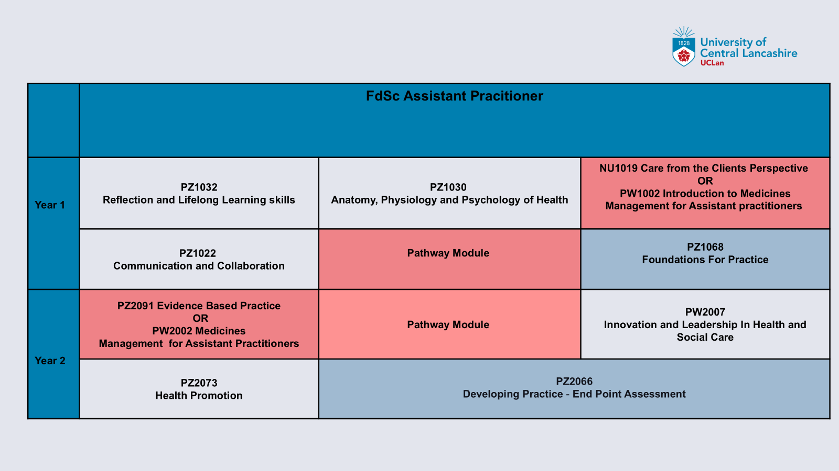
Overview of Taught Modules

Slide 9



Pathways Available-September Cohorts

Slide 10



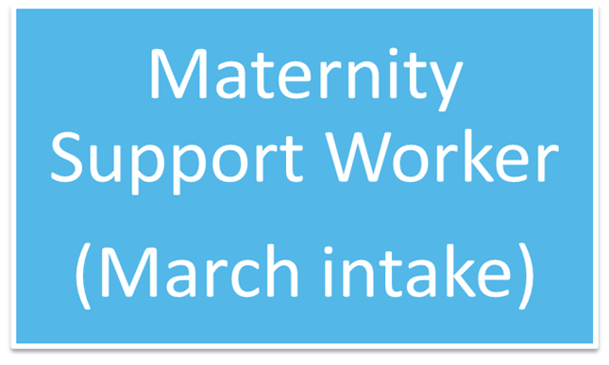
Pathways Available March Cohorts

Slide 11
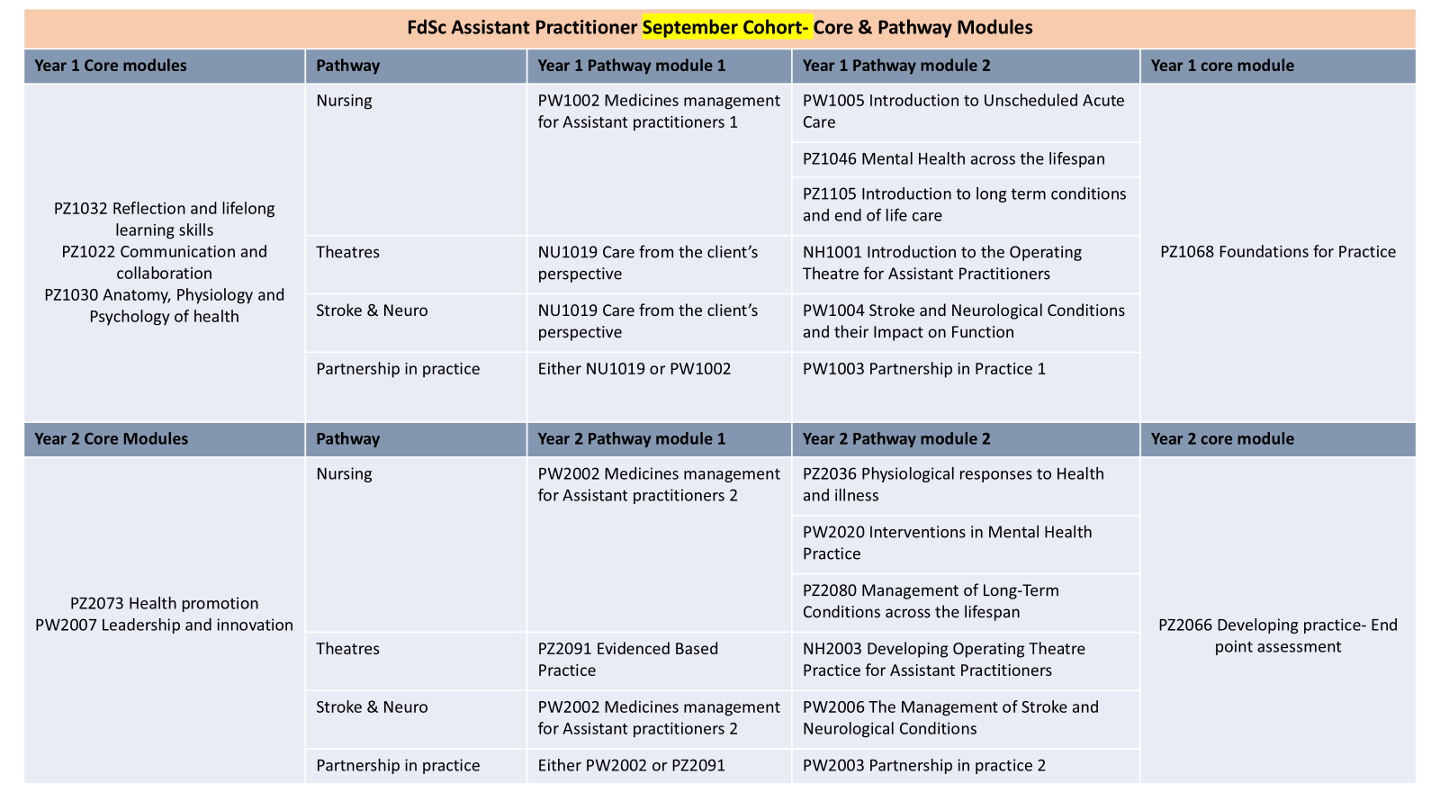

Slide 12
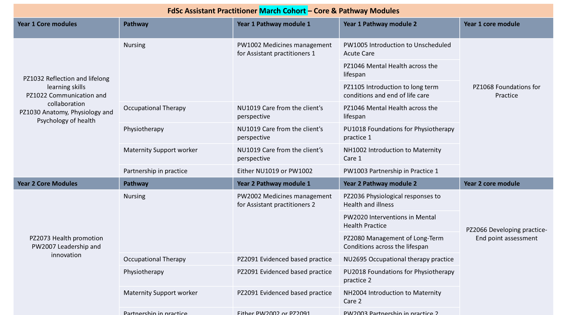

Slide 13
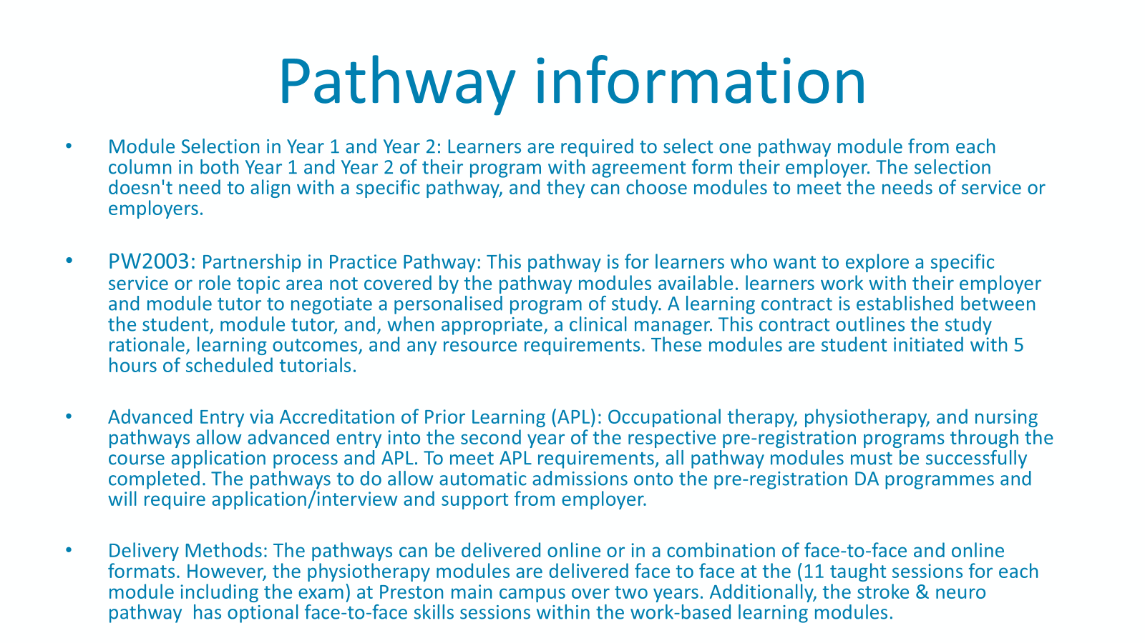

Slide 14
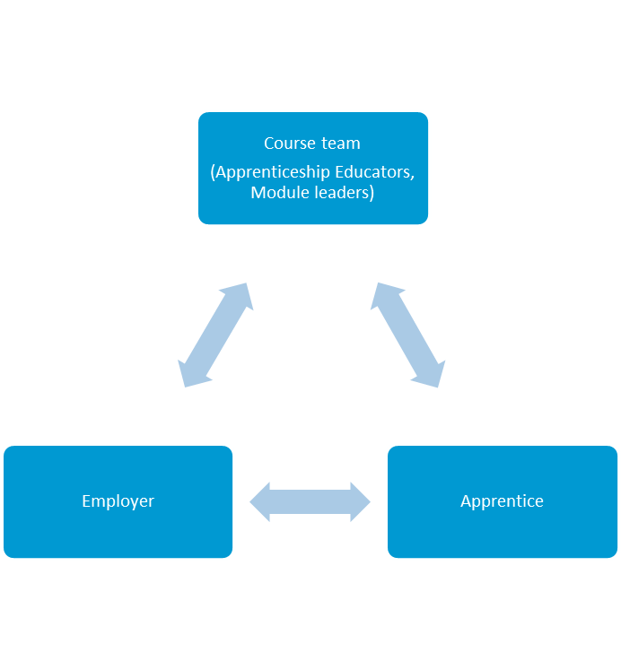
Support Available for our Learners
Tripartite approach to student support
Progress review meetings
Personal Tutor
Apprenticeship Educator
Monitor progression- One file e-portfolio
Manager and mentor events
Mentor / Practitioner Support

Slide 15
Contact Details
Donna Welch (Course leader)
DWelch@lancashire.ac.uk
Terence Jagger (Admissions tutor)
TJagger@lancashire.ac.uk
Course website
https://www.lancashire.ac.uk/degree-apprenticeships/courses/assistant-practitioner-fdsc

